Slide 1
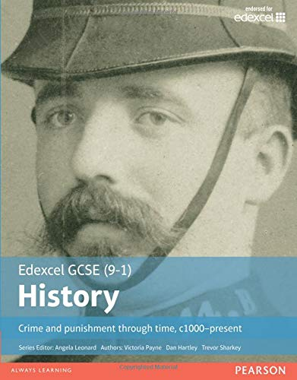
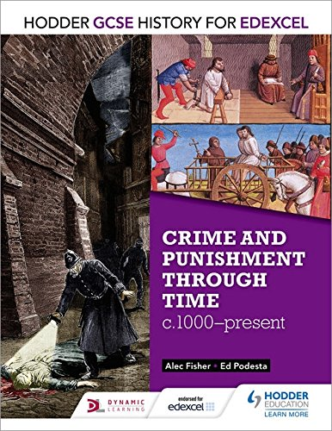
An introduction to Crime and Punishment through time, c.1000-present day
Getting ready for GCSE History
In September, you will be starting your History GCSE with Paper 1: Crime and Punishment through time, c.1000-present day. Over the Summer, we would like you to begin to prepare for this.
In this booklet you will cover
What you think you already know about Crime and Punishment
Develop chronological skills which are necessary for this paper
Gain an understanding of the ‘big picture’ of Crime and Punishment through time and identify how it changed over time
Identify the factors which contributed to why Crime and Punishment changed.
Please complete this booklet over the Summer Holidays and either email to your teacher or hand it in at school in September.
Make sure you are also checking Google Classroom as we will be posting updates to get you ready for this paper.
If you have any questions in the meantime please email your teacher.
Have a lovely Summer and we look forward to seeing you again in September!

Slide 2
What are your attitudes to crime and punishment?
Task 1: Read through the questions and circle which statement you agree with for each question. Think about the reasons why you believe this as we will discuss this in our first class back.
1. What should be the main reason behind punishing criminals?
a) Retribution – revenge to satisfy the victim or their families | b) Deterrence – to warn others not to commit the same crime
c) Reform – to help the criminal improve their behaviour | d) Removal – to keep the criminals of the streets
2. Should capital punishment (the death penalty) be brought back?
a) Yes, for all murders | b) Yes, for some murders
c) Yes, for certain types of serious crime | d) No
3. Should physical punishments, such as whipping, be used against criminals?
a) Yes | b) No
4. Should be police carry guns?
a) Yes, all the time | b) No, unless there is a dangerous situation to deal with
c) Only in some areas | d) Never
Key Words
Write down your own definition of each key word
Retribution
Deterrence
Reform
Removal
Capital Punishment

Slide 3
What do you already know about crime and punishment?
Task 2: Read through the questions and circle which statement you think is correct.
1. In the last ten years crime has:
a) Risen dramatically | b) Stayed roughly the same
c) Fallen
2. Who is more likely to be the victim of a mugging?
a) A female pensioner | b) A male pensioner
c) A female under 29 | d) A male under 29
3. Yearly numbers of murders and killings are:
a) Slightly higher than they were ten years ago | b) Considerably higher than they were ten years ago
c) Slightly lower than they were ten years ago | d) Considerably lower than they were ten years ago
4. In the last ten years, car crime (theft of cars and possessions from cars) has:
a) Increased dramatically | b) Increased a little
c) Decreased | d) Decreased dramatically
5. Women are more likely than men to be attacked by a stranger?
a) True | b) False

Slide 4
6. Burglary is:
a) Increasingly dramatically | b) Increasingly a little
c) Decreasing | d) Decreasing dramatically
7. What percentage of rimes are violent?
a) 50 percent | b) 35 percent
c) 10 percent | d) 3 percent
Answers to Crime Quiz
1c; 2d; 3d; 4c; 5b; 6c; 7d

Slide 5
Understanding Chronology
In this topic, you are going to cover 1000 years of History. Therefore it is important that your knowledge of chronology (the names and sequences of different historical periods) is strong and you can confidently write about these different historical periods.
Place these four historical periods in chronological order. The first one has been done for you.
•The twentieth century •The Middle Ages •The Early Modern Period •The Eighteenth and Nineteenth Centuries
Earliest Period
The Twentieth Century
Most Recent Period
2. Roughly, what dates does each period cover. The first one has been done for you.
The Twentieth Century | 1900-1999
The Middle Ages
The Early Modern Period
The Eighteenth and Nineteenth Century
3. Place these events in the correct chronological order.
The Black Death
The Renaissance
The Industrial Revolution
The Norman Conquest
The First World War
The English Civil War
4. You are going to study four pictures (picture A-D.) With each picture, you need to identify
Which chronological period you think the picture is from
What do you think is happening in each picture
What can you work out from each picture about Crime and Punishment at that time? Does it reveal a type of crime, a method used to enforce the law or a method used to punish criminals?

Slide 6
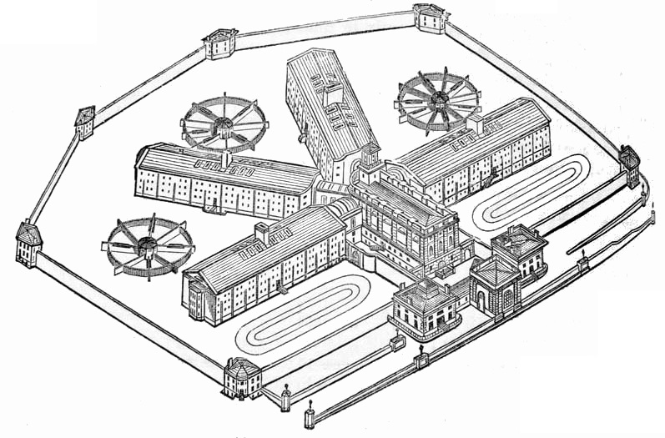
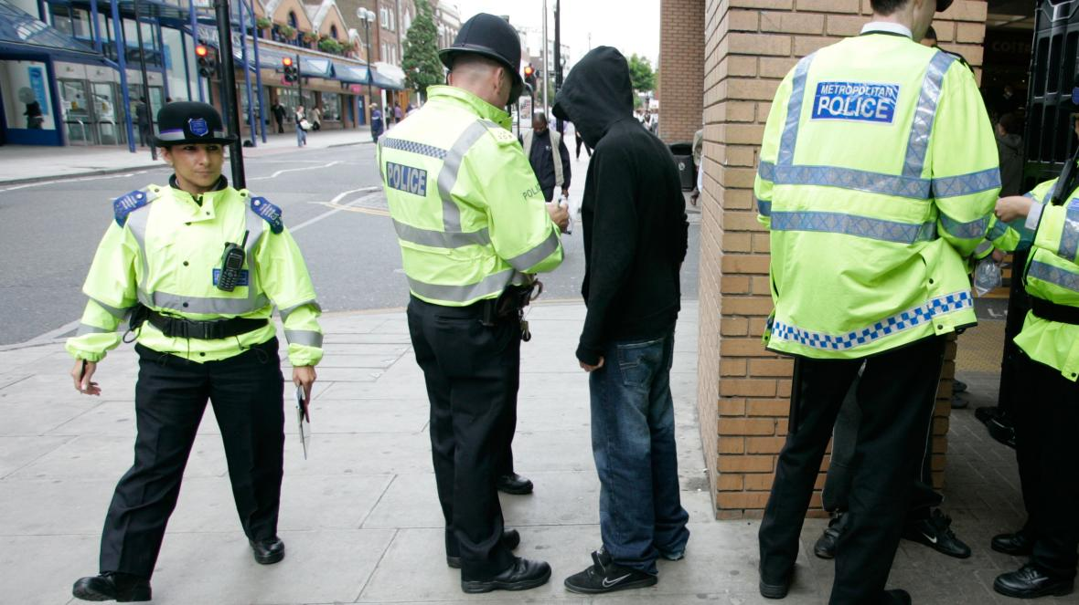
Which chorological period?
What do you think is happening in this picture?
What does this reveal about Crime and Punishment at that time period?
Which chorological period?
What do you think is happening in this picture?
What does this reveal about Crime and Punishment at that time period?

Slide 7
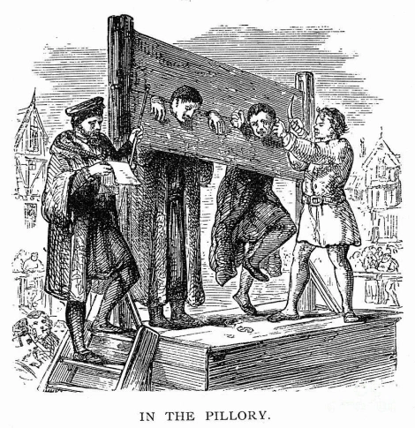
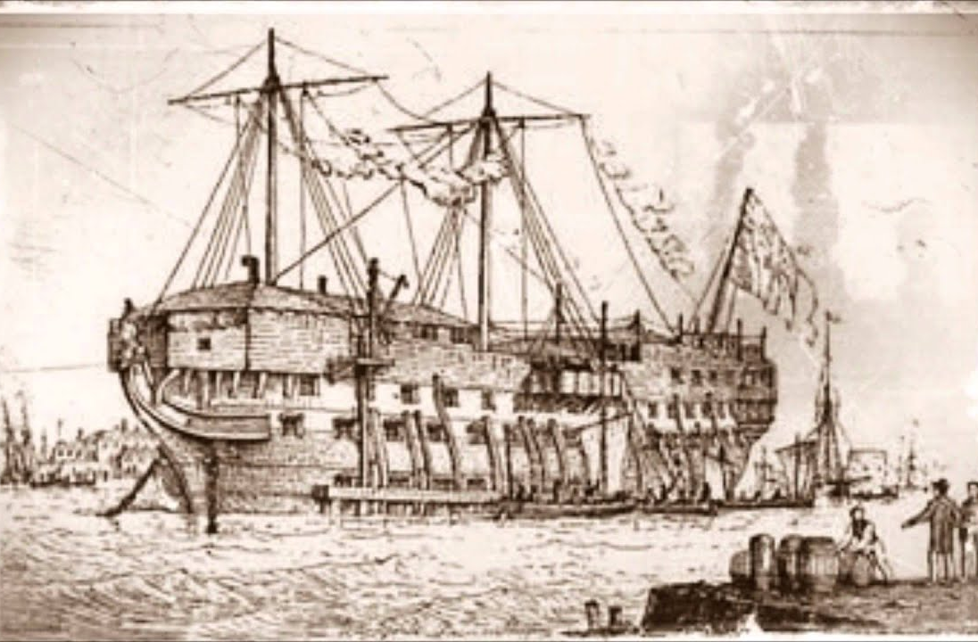
Which chorological period?
What do you think is happening in this picture?
What does this reveal about Crime and Punishment at that time period?
Which chorological period?
What do you think is happening in this picture?
What does this reveal about Crime and Punishment at that time period?

Slide 8
The Big Story of Crime and Punishment
Throughout this topic, you will study the crime and punishment over 1000 years. We will focus on four periods:
1000-1500
1500-1700
1700-1900
1900-present day
For each period in time we look at, you will learn about
Criminal Activity – what people thought was a crime
How the law was enforced
How criminals were punished
On the next page, there is an overview of Crime and Punishment 1000-1500. (Please be mindful this is an overview and not the complete story of Crime and Punishment.)
Task: Using the pages provided, create your version of a mind map for each of the four time periods.
You must include these three headings
Criminal Activity – What was the nature of crime in each period
Methods used to enforce law – What was the role of authority and communities in law enforcement
Methods used to punish criminals – What was the main purpose of punishment?

Slide 9
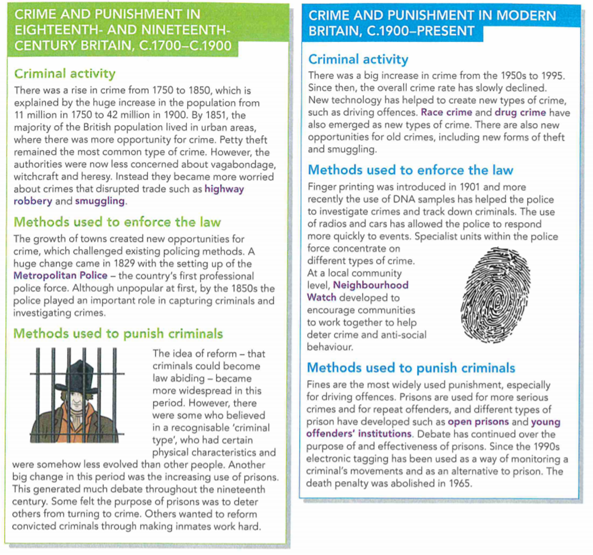

Slide 10
Crime and Punishment 1000-1500

Slide 11
Crime and Punishment 1500-1700

Slide 12
Crime and Punishment 1700-1900

Slide 13
Crime and Punishment 1900-present

Slide 14
Why changes happened – and didn’t
The focus of this topic is both how crime changed over time (which you will have seen in the previous task) and then importantly why crime and punishment changed.
Here you will learn about the factors (the reasons) for changes in crime and punishment or the reasons for staying the same.
Read the diagram above
The factors above the triangles have had the most important impact on Crime and Punishment throughout History.
The factors below the triangle have been important in certain periods of history but not as consistently throughout time.
Task: Choose two of the factors above and decide which period of time you think it would have had the most impact on and why.
Factor | Which time period do you think this factor impacted the most? | Explain why you think this.

Slide 15
Task: Below are three important moments in the History of Crime and Punishment. Read through each moment and identify which factors are influencing the people and events described in each one.
Event | Which factors?
The Gunpowder Plot
The First Police Force in London
Capital Punishment is abolished

