Slide 1
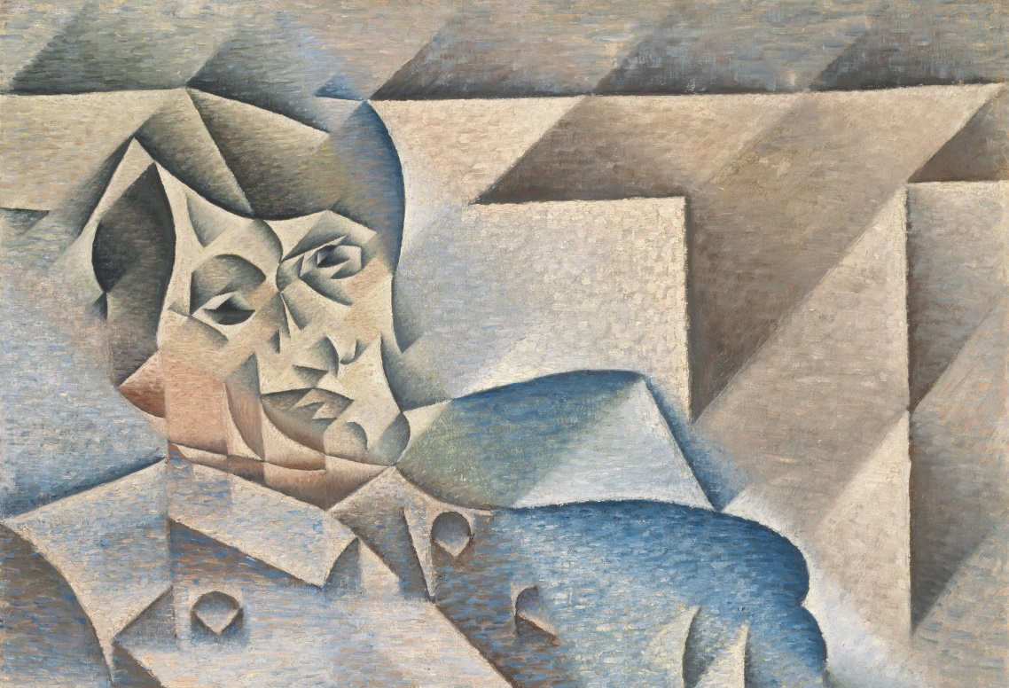
LO: Analyse and respond in writing to an artwork. Consider the composition and presentation of your work.
Answer the following questions about this painting. You must write in full sentences and use key words where you can.
Key words:
Analyse Respond Composition Presentation
Describe in detail what you can see in this painting
What do you notice when you first look at this painting?
How are the colours in this painting different to other paintings?
How does this painting make you feel?
What do you like about this painting?
What don’t you like about this painting
Key words: LO: Analyse and respond in writing to an artwork Consider the composition and presentation of your work.
Key words…Analyse Respond Composition Presentation

