Slide 1
Notes:
This lesson on respect is the first out of five sessions in the Army’s Character Education series. Each lesson can work as part of the series, or as a standalone lesson.
The lessons are supported by a set of five immersive films that follow two young people navigating a devastating national power cut. As chaos ensues they must dig deep and show strength of character.

Slide 2
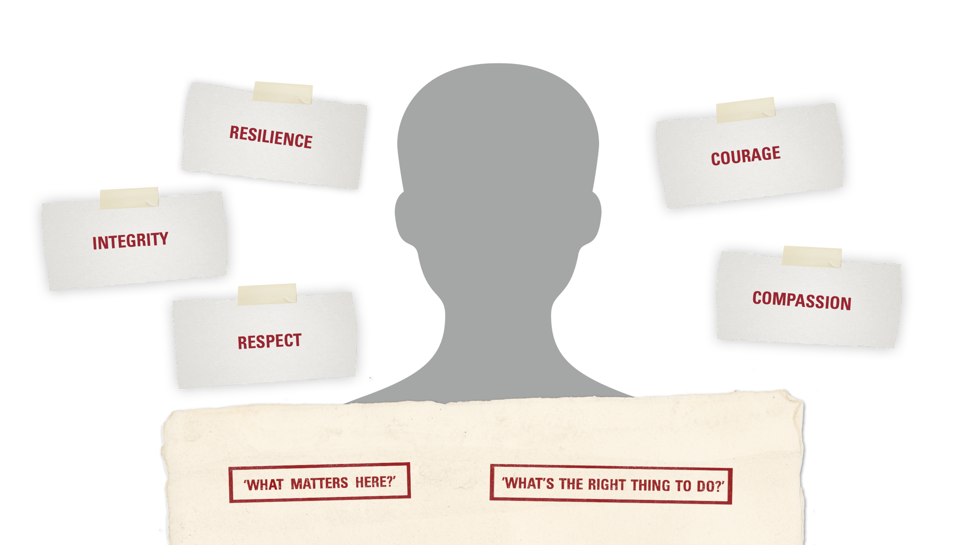
WHAT IS ‘CHARACTER’?
RESPECT | INTRODUCTION
Character is the positive values and qualities that help us to work out:
and
Notes:
Use this optional slide to introduce the meaning of ‘character’.
Before showing the slide, ask students to write down their definitions of the word ‘character’ on A4 pieces of paper and hold them up to each other. Reflect on whether the definitions feel similar, or whether there are a variety of interpretations.
Suggest an answer: a person’s character describes their unique combination of values and personal qualities.
Briefly introduce the idea of ‘values’: they are the ideas or principles that guide how we decide what is right or wrong, and what is the right thing to do in any situation. (Link the concept of character, and these values, to your school’s ethos and values.)
Explain that this series of lessons will help students to explore these values and apply them in them own lives.

Slide 3


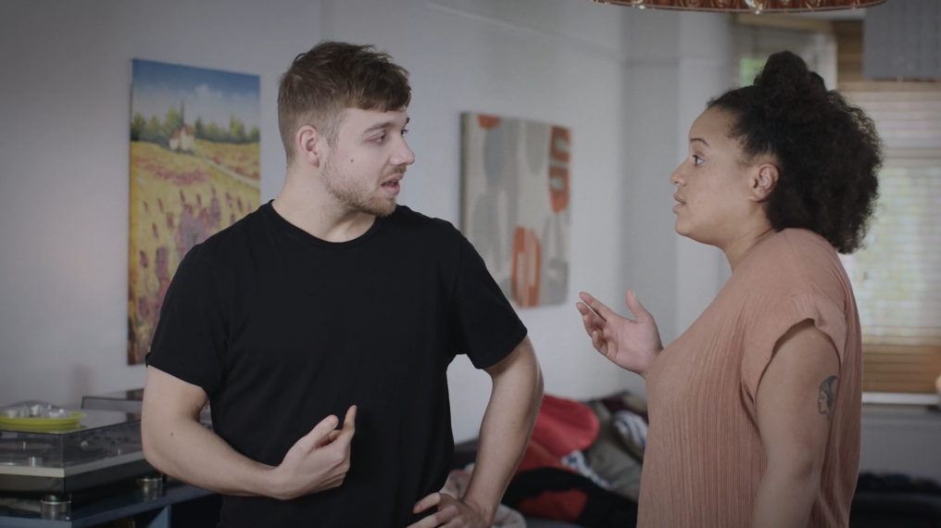
RESPECT | FILM
Notes:
Respect video. This video is the first chapter of a five part series of films used across the Army’s Character Education lessons.
The films portray a nationwide power cut caused by a cyber attack. Our characters, Ben and Alex – an Army reserve – consider the implications of the situation and try to plan ahead.
Discussion questions
1. What might it feel like to suddenly lose all power?
2. What might people worry about, and why?
3. What particular problems might specific people or organisations have? (E.g. NHS, supermarkets, IT, families with babies or young children, the elderly, emergency services.)
4. How might people need to work together? Do you think people could work together well in these circumstances? What problems might arise?

Slide 4
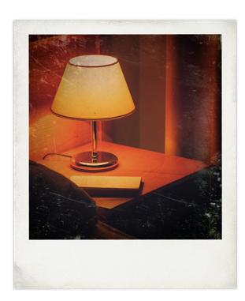
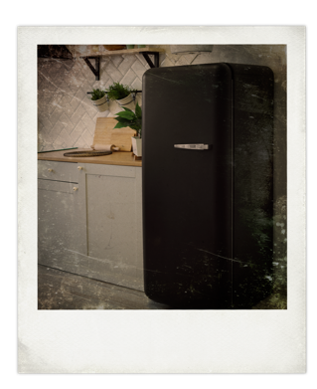

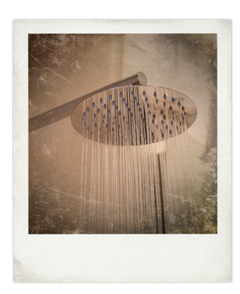
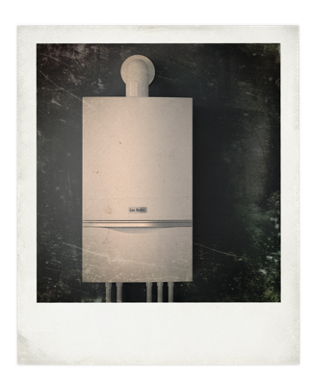
ARMY BRIEF: MAKE A PLAN
A cyber attack has caused a nationwide power cut. You don’t know how long it is going to last.
Make a plan to get through the next 48 hours.
RESPECT | STARTER
Which items and supplies will you gather together?
How will you store water?
What items do you need to protect?
Who will you check on?
What will you share, and with who?
Notes:
Following the film students should divide into groups and imagine that they themselves are experiencing the blackout. They should follow the Army’s brief and work together.
Using the stimulus on the slide, students must write a simple plan of the most important things they must do to get through the next 48 hours, bearing in mind that they don’t know when the blackout will end.
Support: Students focus on one question.
Hints:
There is no mains electrical power - so most gas appliances or central heating will not work either. Imagine it’s cold outside – how will they deal with this? (e.g. torches, other battery powered items, camping stoves or barbecues)
Which food supplies are the most and least at risk at home (food keeps safe for 4-6 hours in fridges and stay frozen for up to 24 hours in freezers, when there is no power).
Consider how to store water (do this before the water pressure drops – local water supply requires a source of power to maintain).
Who are the most vulnerable people in their family, street or block, or community, and what help will these people need?
Challenge: Students must time prioritise their plan – what would they do first? And why?
Share ideas as a class.

Slide 5
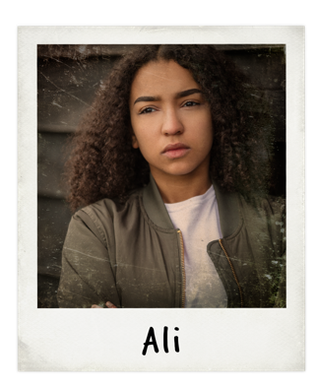
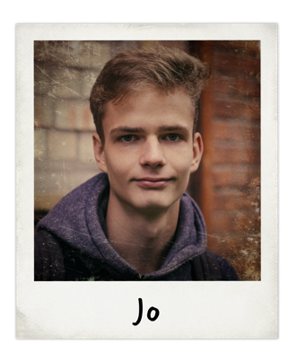
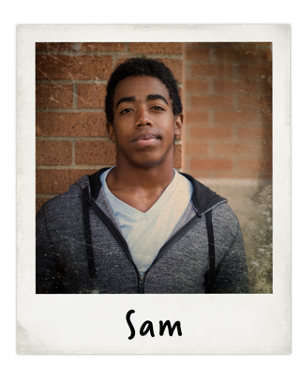
ARMY BRIEF: LISTEN TO EACH OTHER
The power cut brought on by the cyber attack has caused panic and confusion. Public transport has stopped running and shops are closing up.
RESPECT | ACTVITY 1
Everyone reacts differently to a crisis. Sam, Jo, Ali live on the same estate, but have reacted very differently to the cyber attack.
Will they be able to agree what’s best to do?
Notes:
Read through the different reactions of Sam, Jo and Ali to the blackout, which are on slides 7, 8 and 9.
Ask students:
Why might each person have reacted in the way they have?
Which character do you most identify with? Who is most different, and why?
Do you think these three people could work easily together?

Slide 6
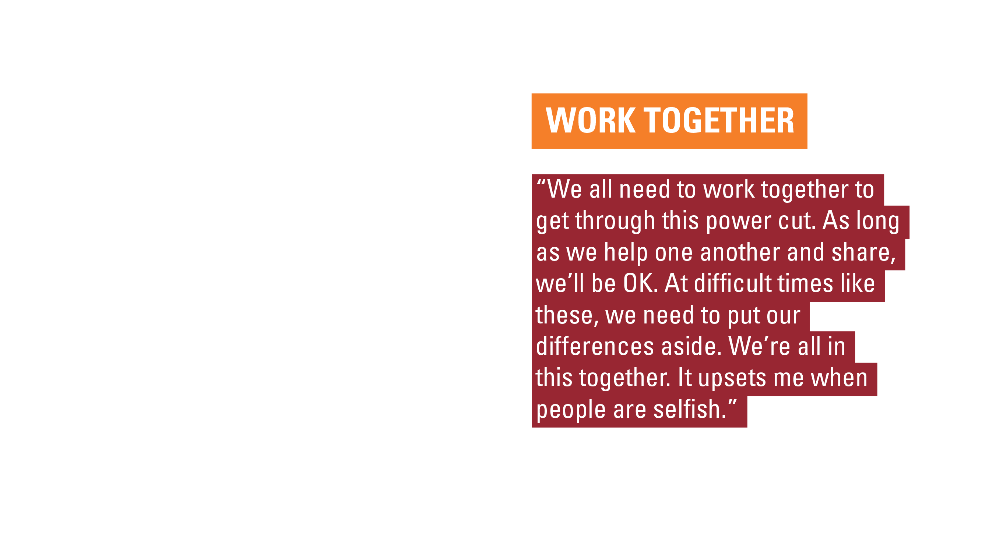
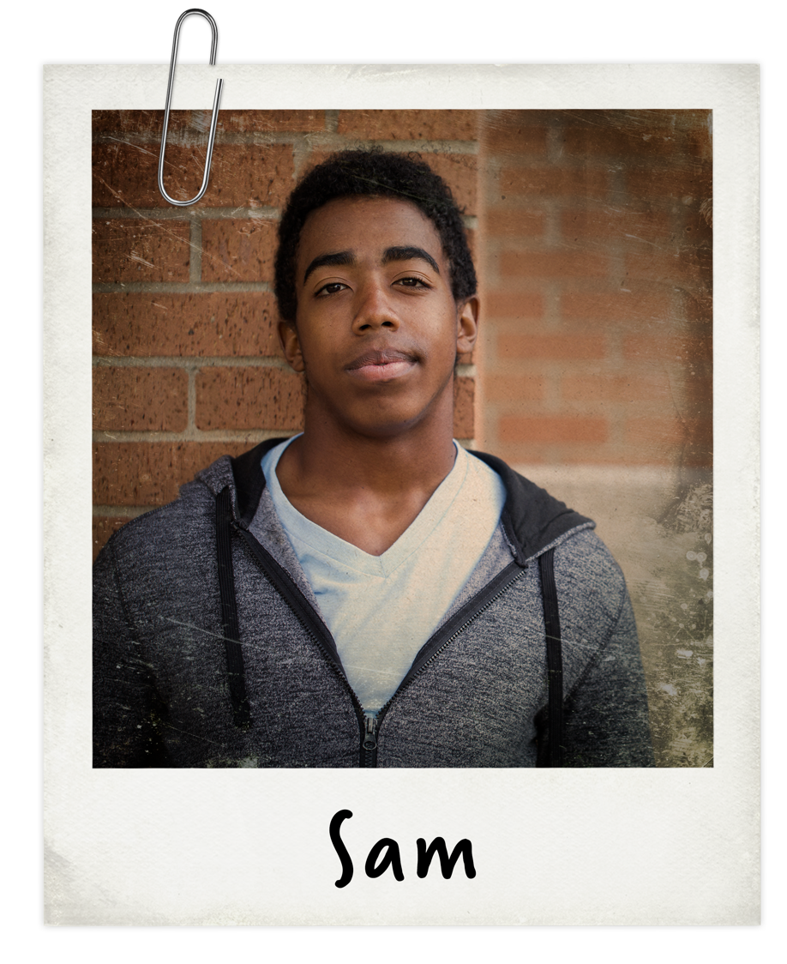
RESPECT | ACTVITY 1

Slide 7
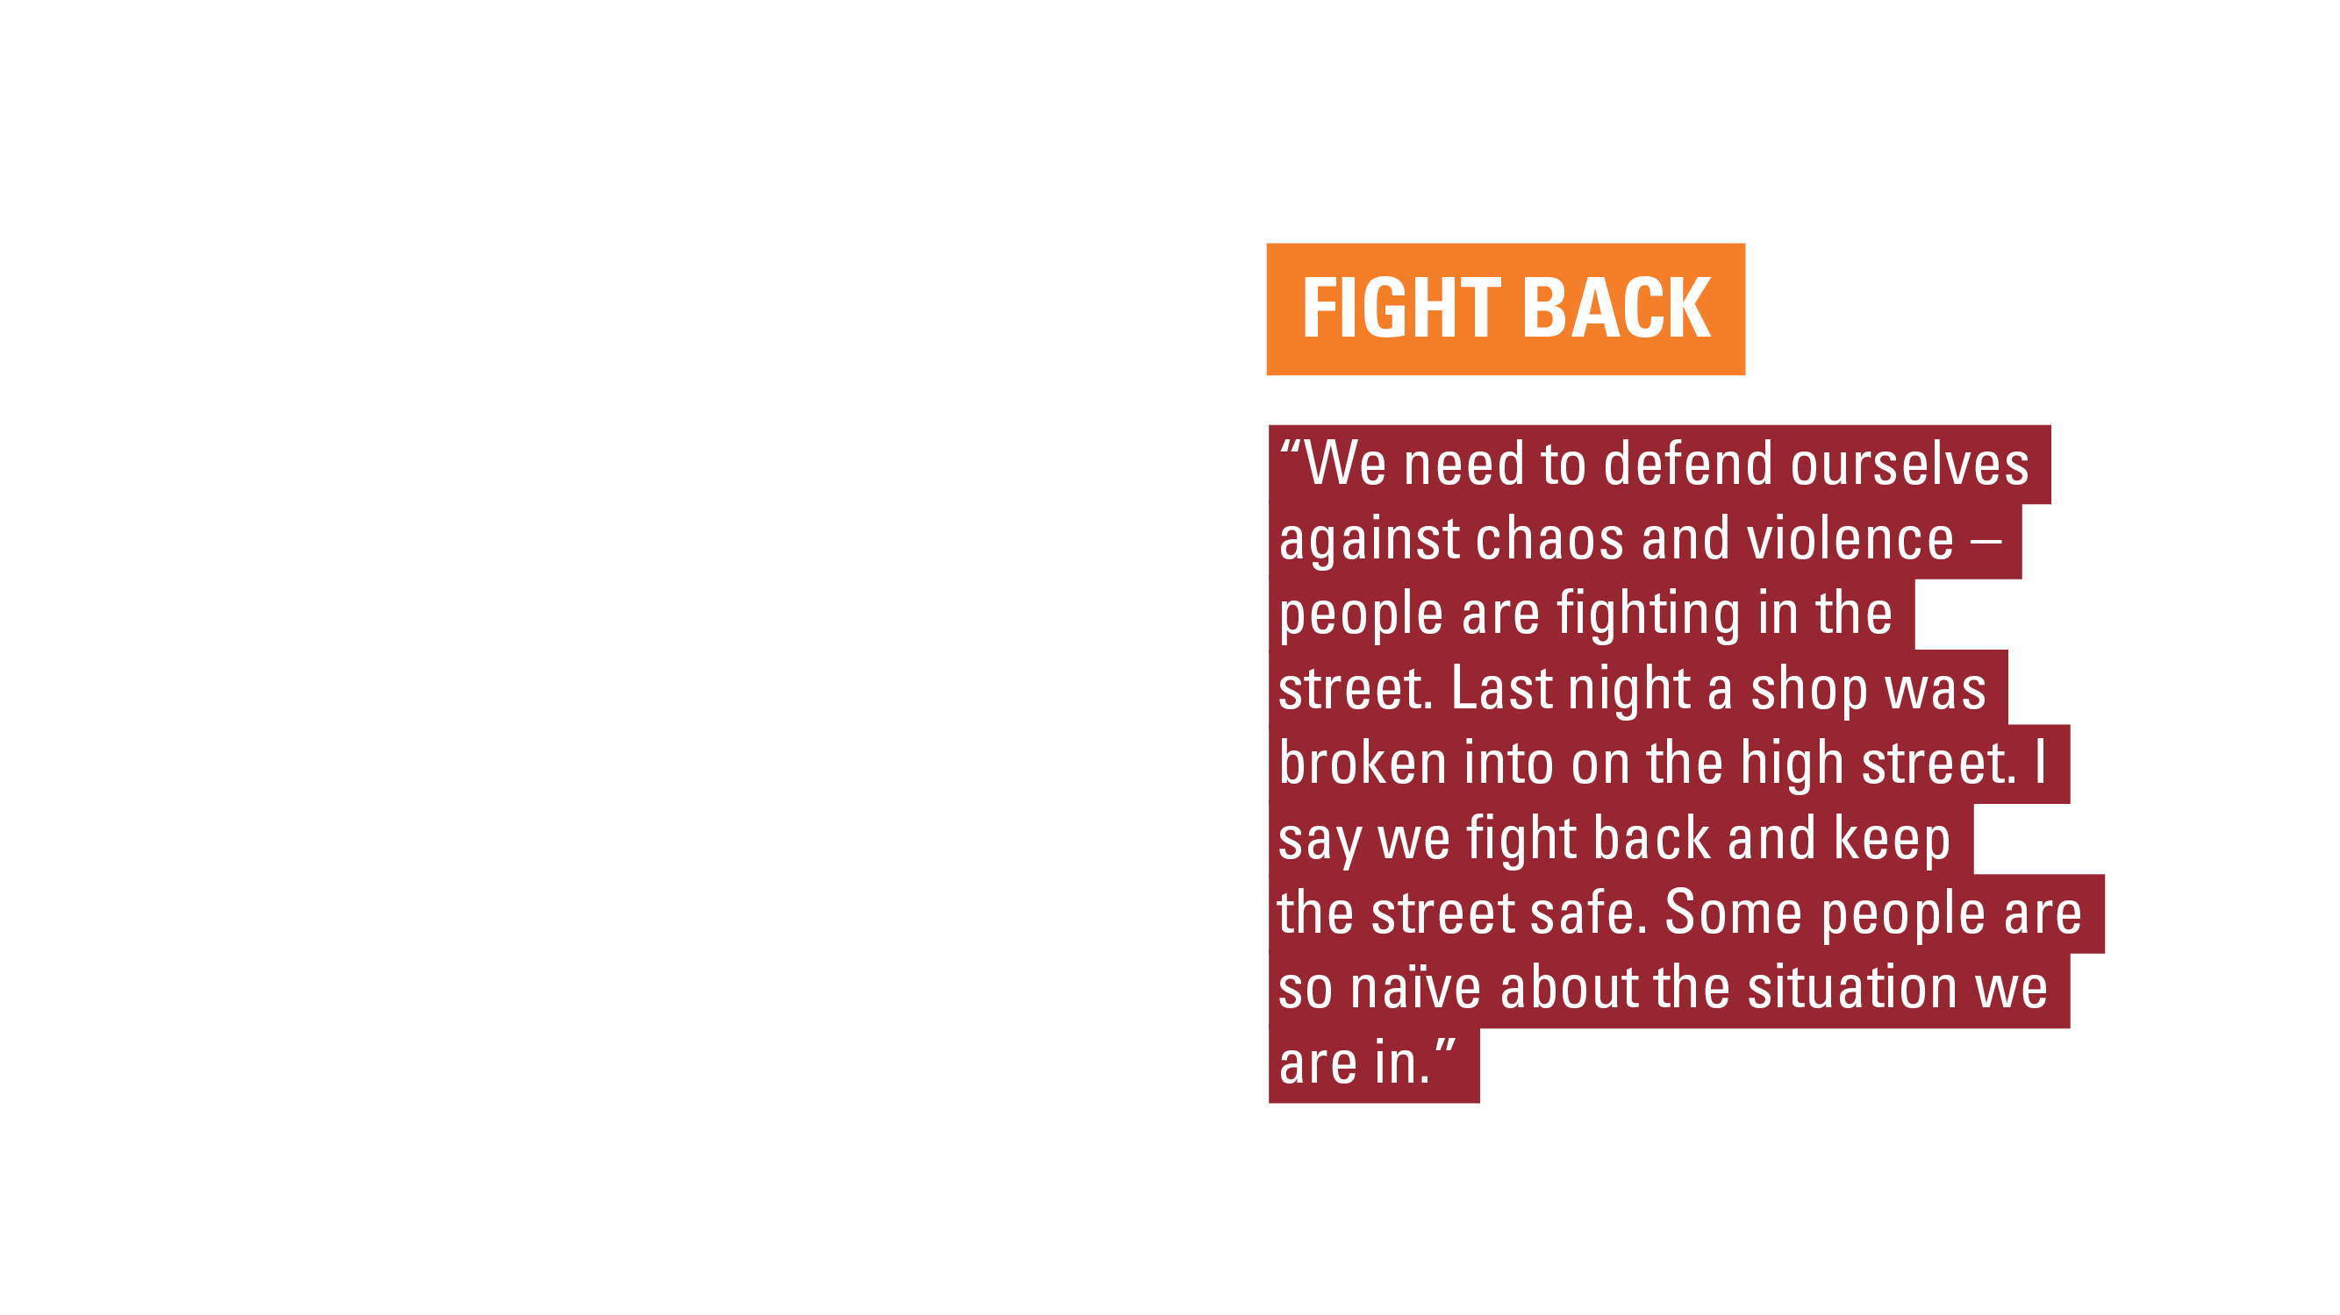
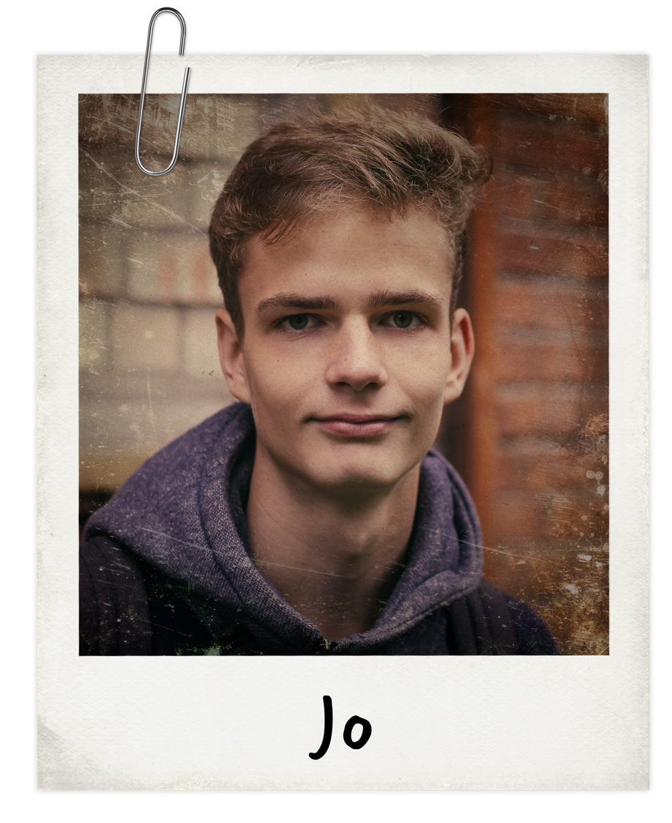
RESPECT | ACTVITY 1

Slide 8
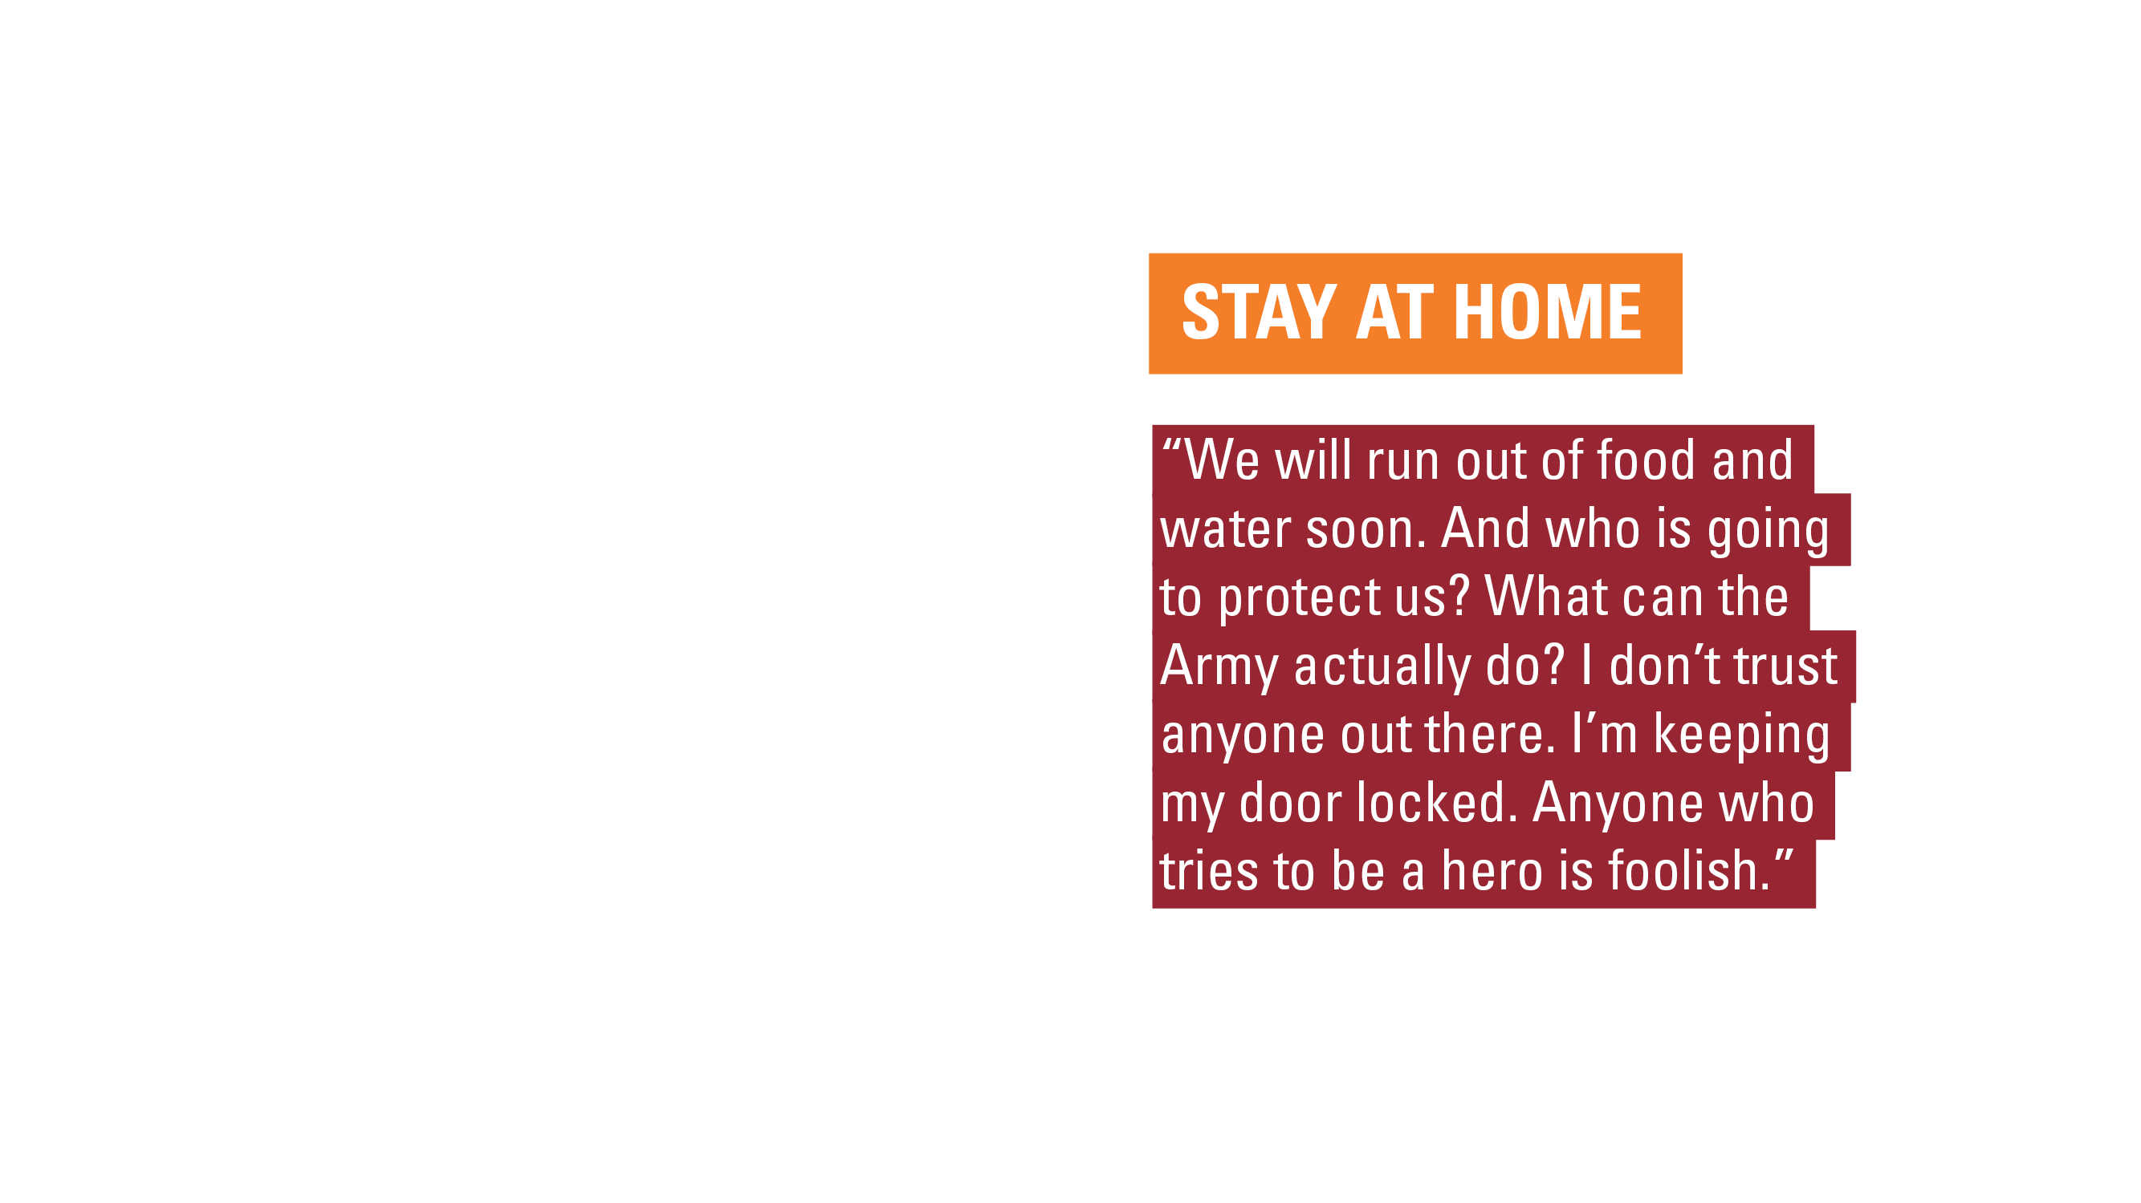
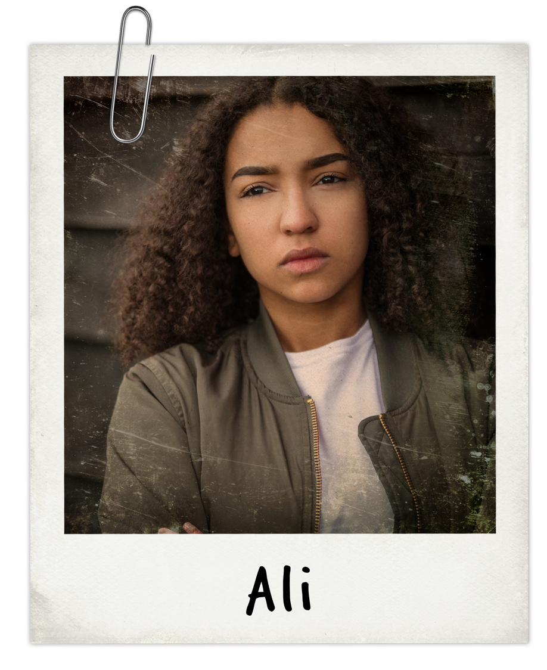
RESPECT | ACTVITY 1

Slide 9

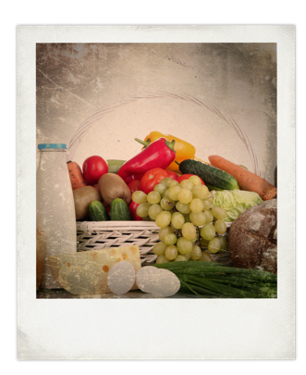
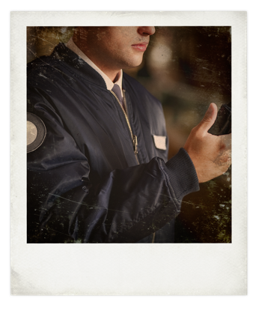
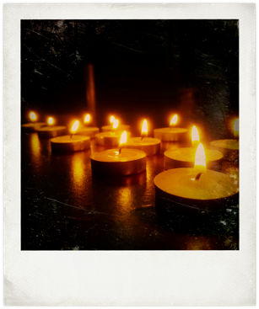

ARMY BRIEF: WORK TOGETHER
It has been several days since the blackout. There is a community meeting to vote on a neighbourhood action plan.
RESPECT | ACTVITY 1
Option 1: Stay at home as much as possible. Look after your own families.
Option 2: Share food and supplies equally between everyone.
Option 3: Form patrols to guard shops and houses.
In groups of three debate the options in the characters of Jo, Sam and Ali.
Which option would each one argue for? How would they react to each other’s opinions?
Notes:
Ask students to form groups of three and take on the characters of Sam, Jo or Ali to debate the options on the slide.
In groups of three, students role play the community meeting discussion in the characters of Jo, Sam and Ali.
Give students a minute to first plan what their character will want to say and how they will act out the role.
Then, encourage them to debate passionately (within reason) and embody their characters, reacting to each other as they imagine how the characters would react.
Support: As a class, briefly review together how each character might sound and what they might think, to help students to get into and rehearse their character.
Challenge: Ask students which character they might prefer as a leader, and why?

Slide 10
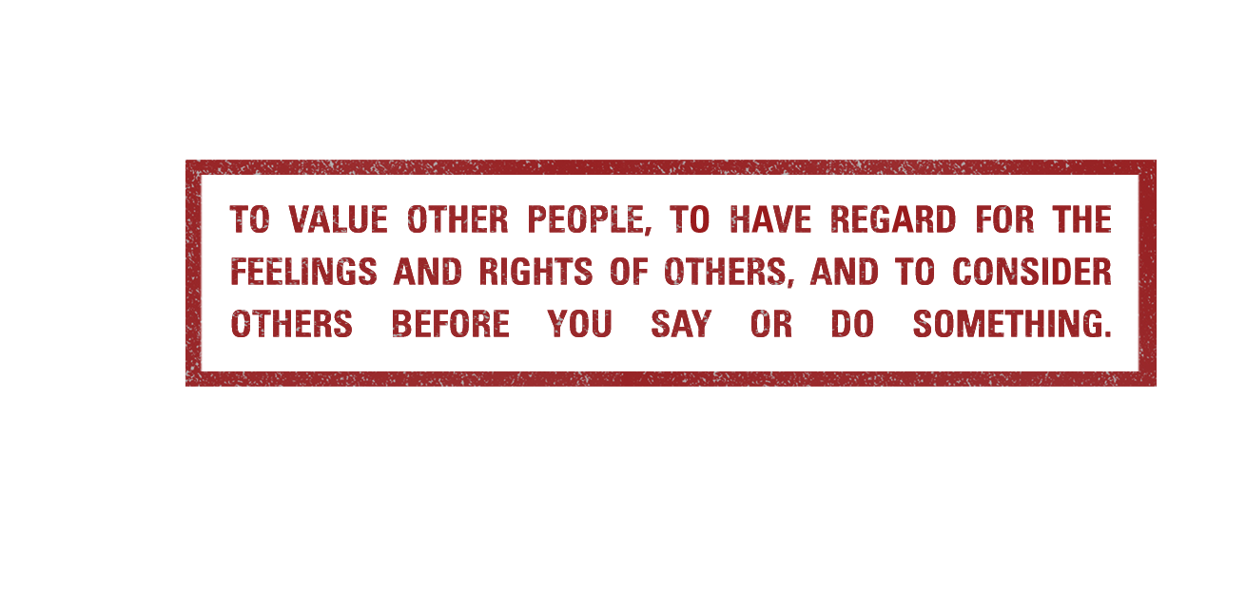
RESPECT
RESPECT | DEFINITION
Notes:
Freeze the role play. Ask students how it felt to share and experience such different points of view when they were in character.
Q. What makes it easier for people of different opinions and backgrounds to reach a consensus?
Introduce the concept of respect, as being key quality to people being able to work together. Ask students to write their own definition of respect using the printable template on slide 14, before showing the definition on this slide.
Share the definition.
Highlight that when we have respect for others, we treat everyone fairly, tolerate different points of view and know it’s important to find the common ground that we can agree on, not the differences that separate us. Respect can mean that we respect what other people think. However, it can also mean respecting the outcome of a decision or vote, even if we were in a minority who did not agree, or respecting a decision made by someone with authority, like a sports referee, a judge, a parent or teacher.
Respecting each other means that we can work together even in times of conflict or crisis.

Slide 11
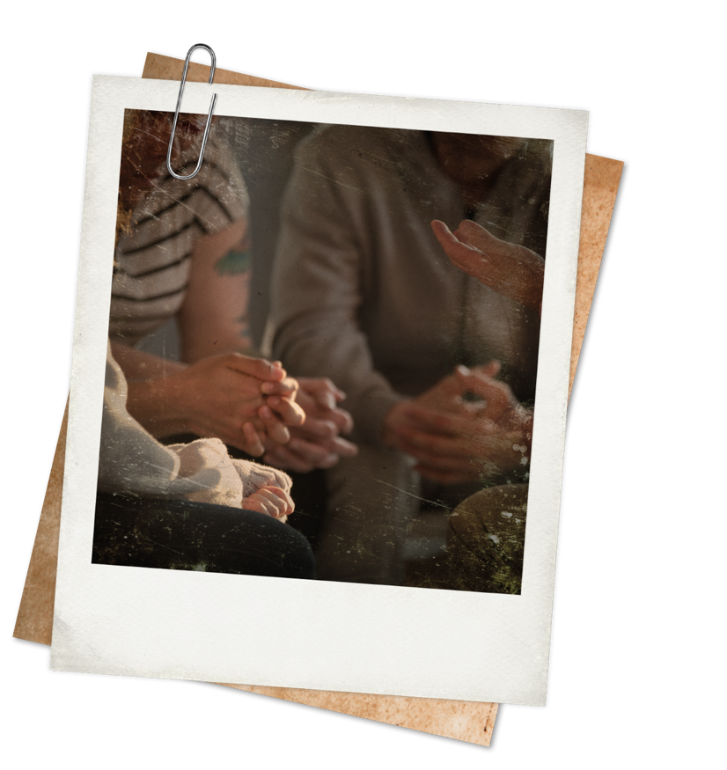
ARMY BRIEF: RESPECT EACH OTHER
Sam, Jo and Ali can only work together well if they show respect towards each other – even if they disagree.
RESPECT | ACTVITY 2
Respectful ways to disagree:
You’ve made a really valid point, now I think that…
I understand where you are coming
from, however…
Continue your debate, taking care to be respectful towards one another.
Reach a consensus and decide which option to take.
Notes:
Resume the character role play from slide 6, but this time students should focus on being respectful to each other during the debate, to agree an option or create a new solution together.
Invite each group to report back. Briefly discuss how showing respect could help the group to agree.
Ask students:
1. How does it feel to be respected?
2. How does it feel when you are not respected?
3. What does showing respect look and sound like?
Students should complete questions 2 – 4 on printable slide 14.

Slide 12
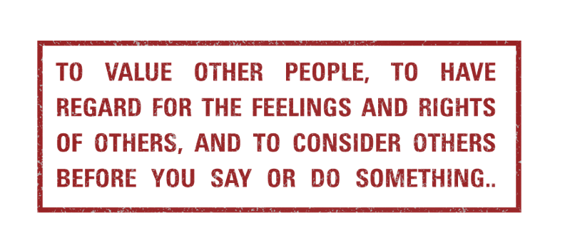
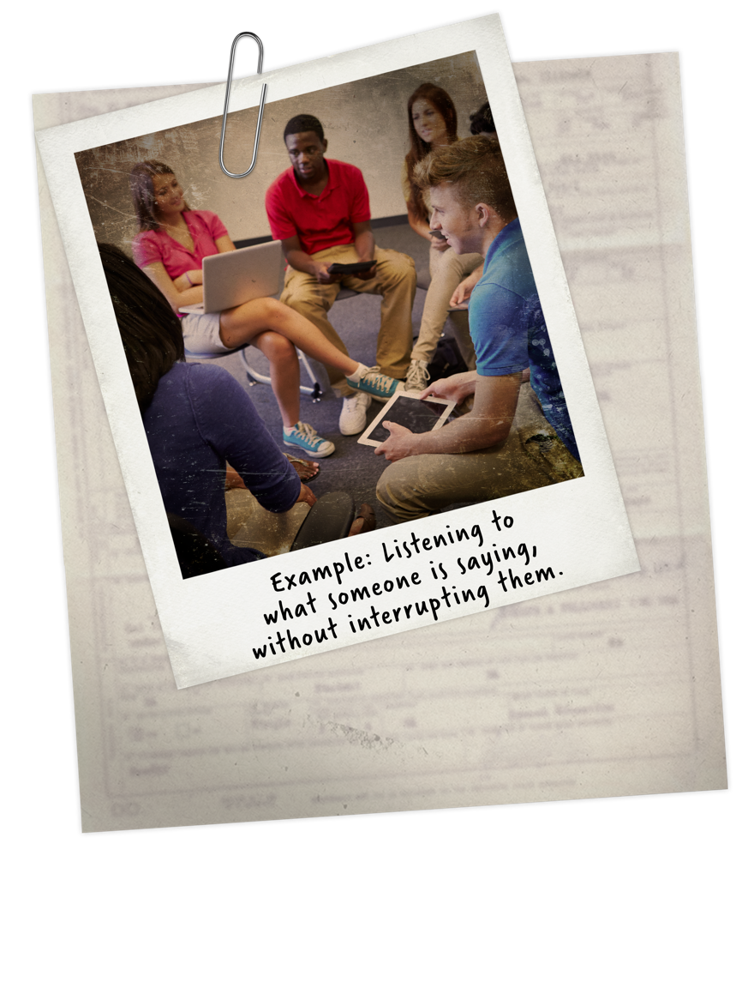
EVERYDAY RESPECT
RESPECT IS:
RESPECT | REFLECTION
Why are we all entitled to be treated
with respect?
Why is it so important for people to
respect each other, even if they don’t agree?
As a class, create some ‘rules of respect’.
Notes:
Reflect on the importance of respect in a school setting. Who needs to have respect for whom, and why? How does this benefit learning and wellbeing?
As a class create some ‘rules of respect’ to use at school. Link this to your school ethos and behaviour code.
Writing task
Students complete their rules of respect on the printable slide, question 5.
Review the learning outcomes for the lesson. How well do students feel they are able to:
Give reasons why it is important to be tolerant of people with different views and ideas?
Explain, using an example, how showing respect can help to diffuse tension and resolve conflict?
Develop and justify a set of rules that have respect at their heart?
Use hands, emojis, a 1-5 scale, RAG rating or your preferred approach.
Optionally, use ‘What went well’ and ‘Even better if’ to help students to reflect on their successes during the lesson and to identify areas they would like to do better.

Slide 13
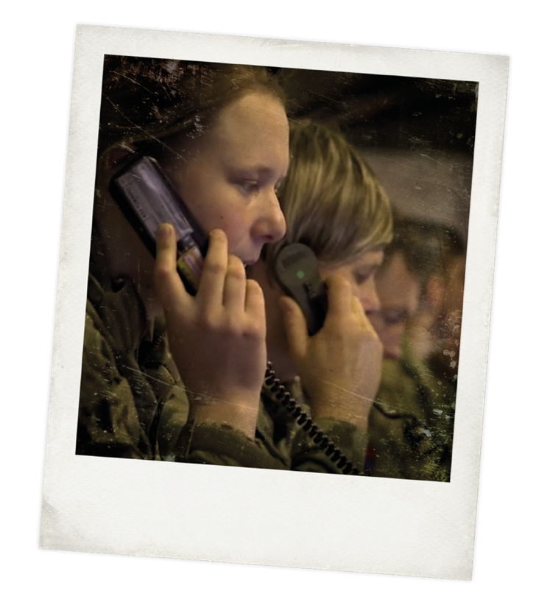
REAL-WORLD RESPECT
Respect for others applies both within the Army itself and when working alongside foreign organisations and services. Members of the British Army must show respect and tolerance for all cultures and faiths – there are currently over 50 religions observed in the British Army.
RESPECT | REAL-WORLD
Mission: Exercise Citadel Guibert 18
Location: Reims, France
The British Army and French Army practice working together, along with other NATO allies, as part of a ‘rapid reaction force’. This means that they are ready to deploy immediately in the event of a crisis needing their help, including disaster relief. The different nationalities need to work seamlessly together as allies – only achievable through complete respect for each other.
Notes:
Extension case study
Q. Why do you think it is important for members of the British Army to be respectful to other people?
Q. The British Army works closely with its allies from around the world. What can be the challenges of working with other people in high-pressured situations?
Q. The Army works in many different places around the world. How can members of the Army respect their environment at all times?

Slide 14
THINKING ABOUT...RESPECT
1. My definition of respect is:
5. My rules of respect are:
1.
2.
3.
4.
5.
6.
2. How does it feel to be respected?
3. How does it feel when you are not respected?
4. What does showing respect look and sound like?
RESPECT

