Slide 1
Notes:
This lesson on integrity is the second out of five sessions in the Army’s Character Education series. Each lesson can work as part of the series, or as a standalone lesson.
The lessons are supported by a set of five immersive films that follow two young people navigating a devastating national power cut. As chaos ensues they must dig deep and show strength of character.

Slide 2
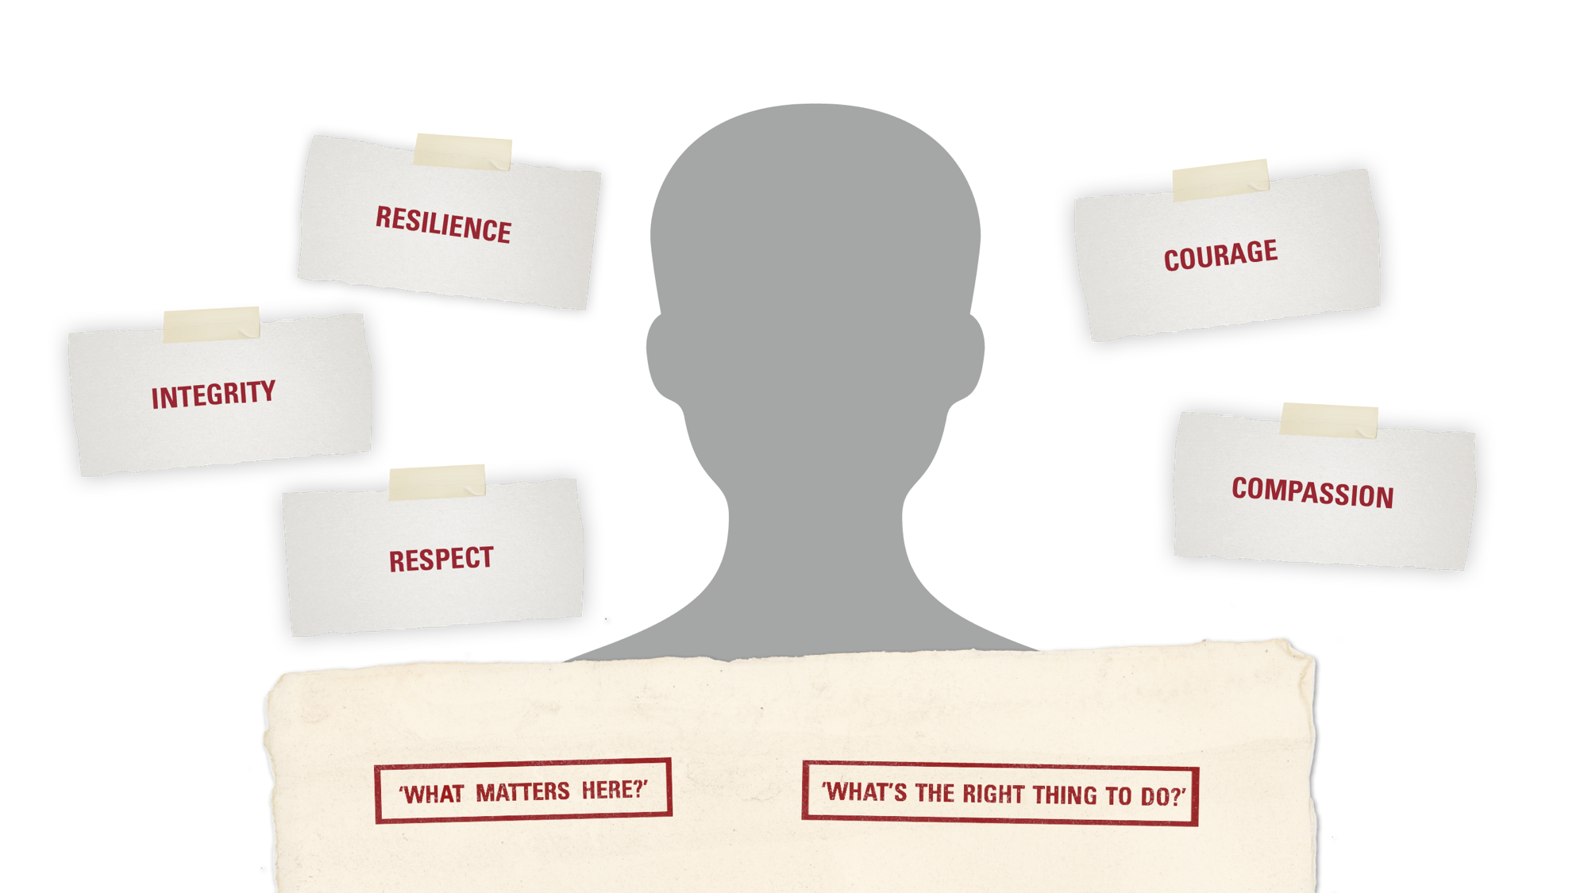
WHAT IS ‘CHARACTER’?
INTEGRITY | INTRODUCTION
Character is the positive values and qualities that help us to work out:
and
Notes:
Use this optional slide to introduce the meaning of ‘character’.
Before showing the slide, ask students to write down their definitions of the word ‘character’ on A4 pieces of paper and hold them up to each other. Reflect on whether the definitions feel similar, or whether there are a variety of interpretations.
Suggest an answer: a person’s character describes their unique combination of values and personal qualities.
Briefly introduce the idea of ‘values’: they are the ideas or principles that guide how we decide what is right or wrong, and what is the right thing to do in any situation. (Link the concept of character, and these values, to your school’s ethos and values.)
Explain that this series of lessons will help students to explore these values and apply them in them own lives.

Slide 3
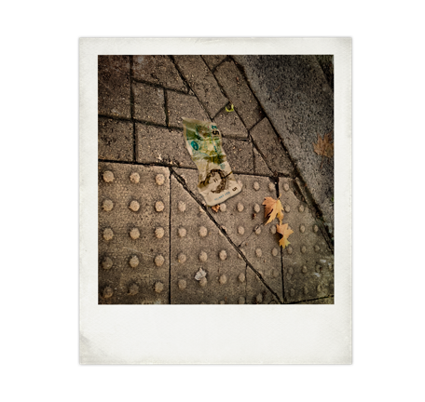
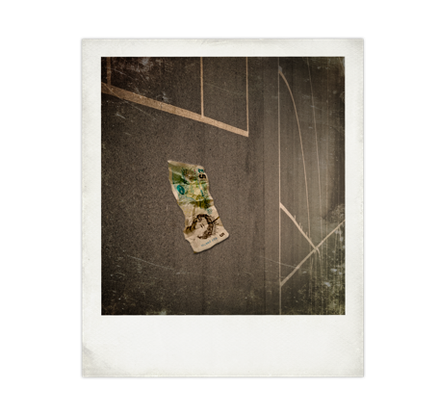
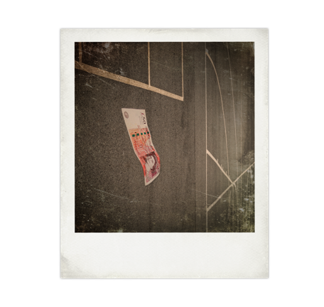
INTEGRITY: WHAT DOES IT MEAN?
INTEGRITY | STARTER
Imagine that you are in
the street and you find a
five pound note.
Do you think most
people would…
Now imagine that you
are in the school playground and you find a five pound note.
Do you think most
people would…
Now imagine that you are in
the school playground and
you find a fifty pound note.
Do you think most
people would…
Option 1: Keep it
Option 1: Keep it
Option 1: Keep it
Option 2: Try and find the owner or hand it in somewhere.
Option 2: Try and find the owner or hand it in somewhere.
Option 2: Try and find the owner or hand it in somewhere.
Notes:
Read out each scenario. Students who wish to can share their responses. Do students feel differently about the different scenarios?
It’s harder to find the owner of a five pound note in the street than the school playground. Does that change what the right response is? 50 pounds is a much greater sum than 5 pounds – does that change what the right thing to do is?
Now ask students – would their responses be different if a friend had witnessed them find the money? Why might that change their behaviour?
Use these discussions as a springboard to discuss the meaning of integrity. Students should fill out their own definitions of the word using the printable worksheet on slide 15, question 1.
Show the definition on the next slide.

Slide 4

INTEGRITY
INTEGRITY | DEFINITION

Slide 5


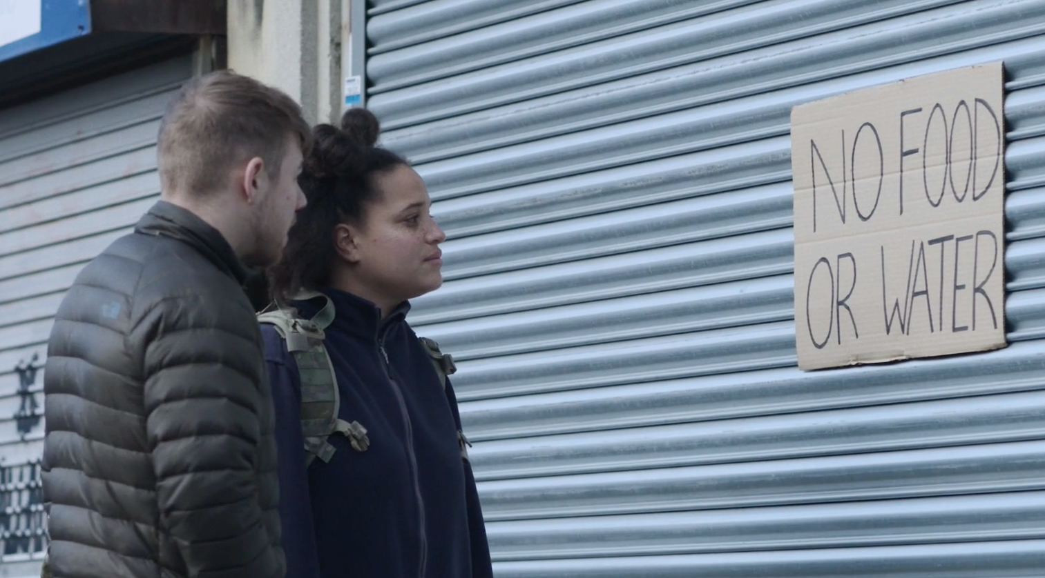
INTEGRITY | FILM
Notes:
Integrity video – A cyber attack has caused a national power cut. Communication networks, transport systems and food supplies have been disrupted. Our characters, Alex and Ben, encounter a shopkeeper selling goods from a warehouse. He has raised prices to account for supply and demand, but has insisted on rationing so that everyone gets the same amount of food. He thinks this is fair. His customers disagree.
Discussion questions:
How would a national blackout affect how shops can store some types of food?
How will a lack of local and national transport affect food availability?
Why might the shop owner want to raise prices? Is this fair?
Why might they want to ration how much each person can buy?
In the film, a woman wants to buy more than her rationed two bottles of water because she has young children. Should the shopkeeper have made an exception for her?

Slide 6
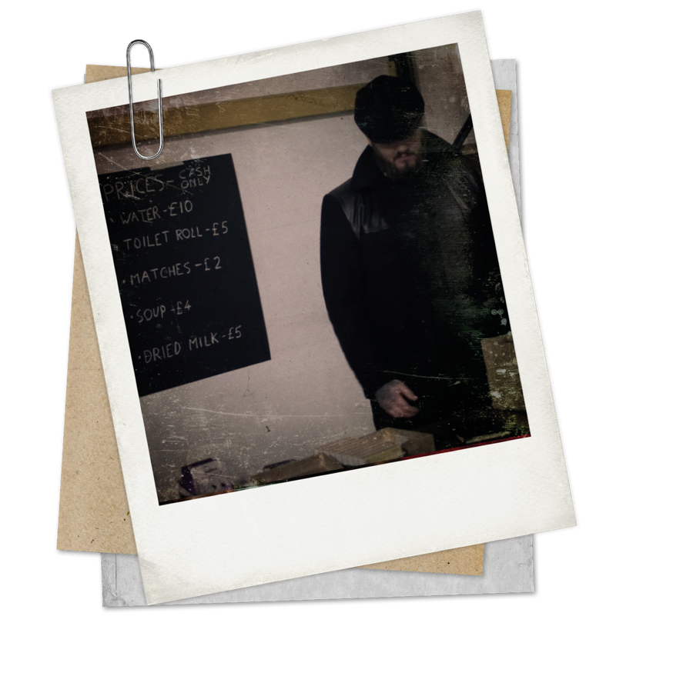

ARMY BRIEF: ACT WITH INTEGRITY
The national power cut has become a crisis. Supply chains have been affected and food stocks are running low.
INTEGRITY | ACTVITY 1
What do you think the rules should be?
What is the fairest solution?
Shops
Option 1: Shopkeepers can choose how much to charge
Option 2: Shopkeepers should not be allowed to raise prices
Customers
Option 1: Customers should be able to buy as much as they want
Option 2: Food should be rationed and shared equally
Notes:
In pairs, ask students to discuss which approach they think is fair and plot their responses on the chart on the next slide. (Either print the slide or ask students to draw it out for themselves.)
Optional prompt questions:
Raising prices: What happens if some people can’t afford the high prices?
Rationing: Would a first come first served system be fair in these circumstances?
Rationing: Is it okay if everyone gets the same share, even if this is more than or less than what they need? (Different family sizes, health conditions etc)

Slide 7
ARMY BRIEF: ACT WITH INTEGRITY
Any price
INTEGRITY | ACTVITY 1
As much as you can buy
Strict, fair rationing
Original price
Notes:
Support. Explain how to interpret the chart: Nearer the centre = weakly agree, further along the axis = strongly agree with the statement.
Students move in the classroom and position themselves to reflect their poach axis.
Active approach. For a more active approach, divide your classroom into four quadrants, like on the chart, with the walls labelled.

Slide 8
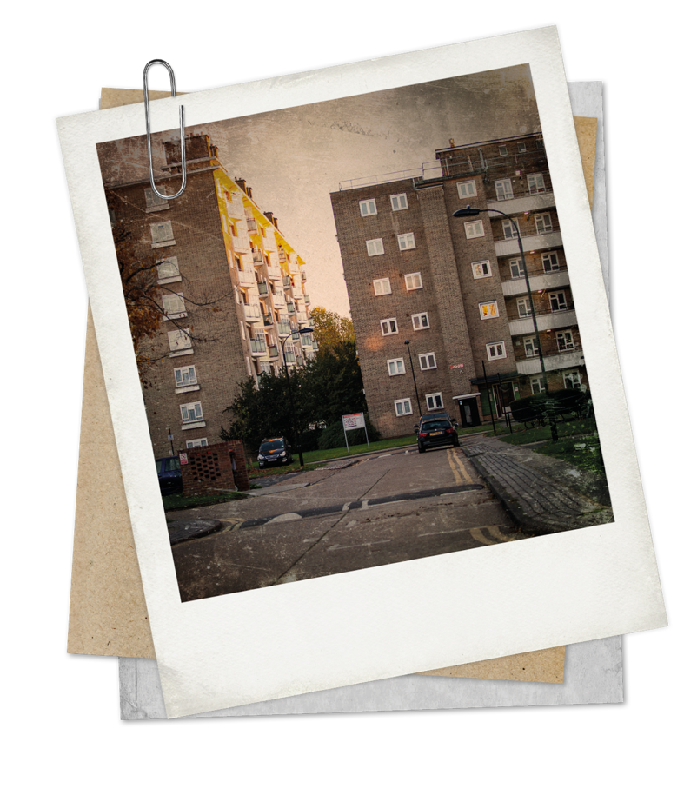
ARMY BRIEF: SHARE SUPPLIES
Ezra, Jaden, Priya, Nora, Indi and Anselm live on the same estate.
They have been asked to share their supplies, using integrity and fairness.
INTEGRITY | ACTVITY 2
What would your character be most worried about?
Stocks are running low. What kind of food would your character most want or need?
What could they give away and share?
Notes:
Integrity task
Explain that students will be working in groups and taking on the character of people living on the slide. As shops run out of food, the characters have to work together to share their food fairly.
Each person has a different background and needs, and a different range of foods they could share. Remind students that no-one knows how long the blackout will last.
Hand out copies of the cards on the next two slides (make sure these are cut up, so students can only see their own card), and a copy of slide 12.
Q. What would each character be most worried about?
Q. What would each person feel able to share with others and what food would they need to keep for themselves?
Q. As a group, decide who gets what, using integrity and fairness.
Groups share their decisions and reasons why.

Slide 9
ARMY BRIEF: SHARE SUPPLIES
NORA
EZRA
PRIYA
Mum, with three children aged 10 months, 3 and 5.
Has no fresh food
SUPPLIES:
30 jars baby food
5 large boxes breakfast cereal
5 cartons UHT milk
Single
Eats out all the time, has almost no food
SUPPLIES:
12 cans cola
2 jars coffee powder
24 oat bars
Lives with partner
Has an allotment
SUPPLIES:
8 large bags frozen fruit, defrosted
12 large bags frozen vegetables, defrosted
10 large bags potatoes
INTEGRITY | ACTVITY 2
Will be worried about:
Will be worried about:
Will be worried about:
Would like from others:
Would like from others:
Would like from others:
Notes:
Nora: Will be worried about food for her baby, needs food that is appealing to small children.
Ezra: Has less useful food to share and is most in need from others, so should be willing to make do with what he is offered.
Priya: Has a large quantity of food that is at risk of spoiling if not used.
Jaden: Will be worried about food for his baby, but has a large quantity of useful food to share.
Anselm: Has meat that will spoil quickly, will want additional food for her parents as well as her sister.
Indi: Has some useful food to share, but not much, so more in need than some of the others.

Slide 10
ARMY BRIEF: SHARE SUPPLIES
JADEN
ANSELM
INDI
Married with four children
Has run out of baby food
SUPPLIES:
2 large bags rice
8 bags dried beans
12 fresh onions
Lives with younger sister
Looks after elderly parents
SUPPLIES:
4 large tubs cooked jerk chicken, defrosted
1 large bag rice
4 trays frozen meat, defrosted
Lives with one teenage son
Was about to do the monthly ‘big shop’
SUPPLIES:
6 tins of soup, beans and vegetables
1 large bag pasta
4 litres milk, still just chilled
INTEGRITY | ACTVITY 2
Will be worried about:
Will be worried about:
Will be worried about:
Would like from others:
Would like from others:
Would like from others:
Notes:
Nora: Will be worried about food for her baby, needs food that is appealing to small children.
Ezra: Has less useful food to share and is most in need from others, so should be willing to make do with what he is offered.
Priya: Has a large quantity of food that is at risk of spoiling if not used.
Jaden: Will be worried about food for his baby, but has a large quantity of useful food to share.
Anselm: Has meat that will spoil quickly, will want additional food for her parents as well as her sister.
Indi: Has some useful food to share, but not much, so more in need than some of the others.

Slide 11

ARMY BRIEF: SHARE SUPPLIES
Ezra will share:
Indi will share:
Jaden will share:
INTEGRITY | ACTVITY 2
Anselm will share:
Priya will share:
Nora will share:
Notes:
Each character should first decide what they can share.
Then, as a group students should decide how to divide up these shared supplies – should some people get more than others? They should make a list and explain their choices to the class.
Highlight that students don’t need to share all their food – they can keep some a secret, to keep it for themselves.

Slide 12
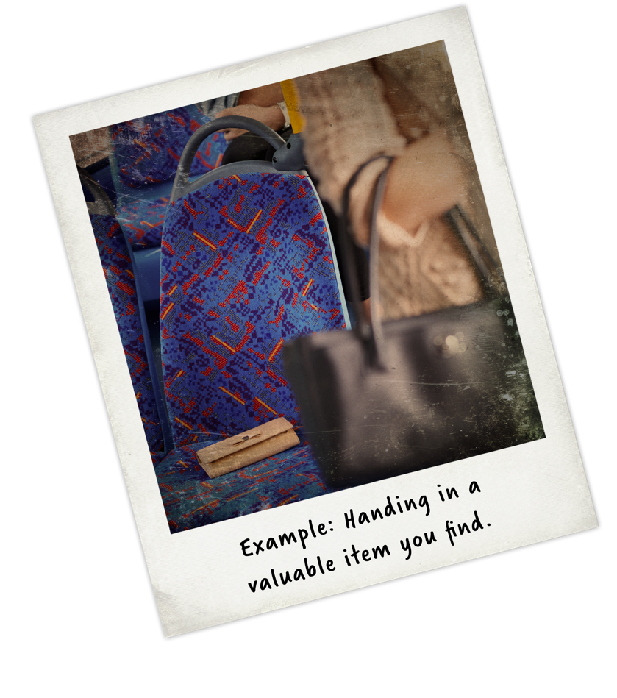


EVERYDAY INTEGRITY
INTEGRITY IS:
INTEGRITY | REFLECTION
Why is acting with integrity so important?
Which of these acts of integrity would
have most impact at your school? And why?
Always contributing equally to a group project
Not plagiarising or copying
Keeping your promises
Speaking out if you see injustices, e.g. bullying
Not talking behind someone’s back, e.g. on social media
Not betraying a friend’s trust in you
Notes:
Students fill out questions 2 and 3 on slide 15.
Review the learning outcomes for the lesson. How well do students feel they are able to:
Describe what it means to act with integrity.
Explain, giving examples, how to act with integrity when sharing limited supplies with others?
Understand how integrity is important for learning and the school community?
Use hands, emojis, a 1-5 scale, RAG rating or your preferred approach.
Use ‘What went well’ and ‘Even better if’ to help students to reflect on their successes during the lesson and to identify areas they would like to do better.
EXTENSION: Follow-on Writing Task
For a cross-curricular link to writing skills in English, students could follow on from this lesson and develop their ideas and understanding with this writing activity:
Aesop’s fables are a collection of tales from the Greek oral tradition, which frequently have a social or moral lesson. Students research some of the fables (free online versions are available) and use these as inspiration to write a brief fable of their own that shows the importance of acting with integrity, for example by showing what can happen to the story’s protagonist if they fail to do so. Students can write in the style of Aesop or in a more modern style and setting more relevant to their own lives. Students can read out or role-play their tales, for their peers to identify the moral story about integrity.

Slide 13
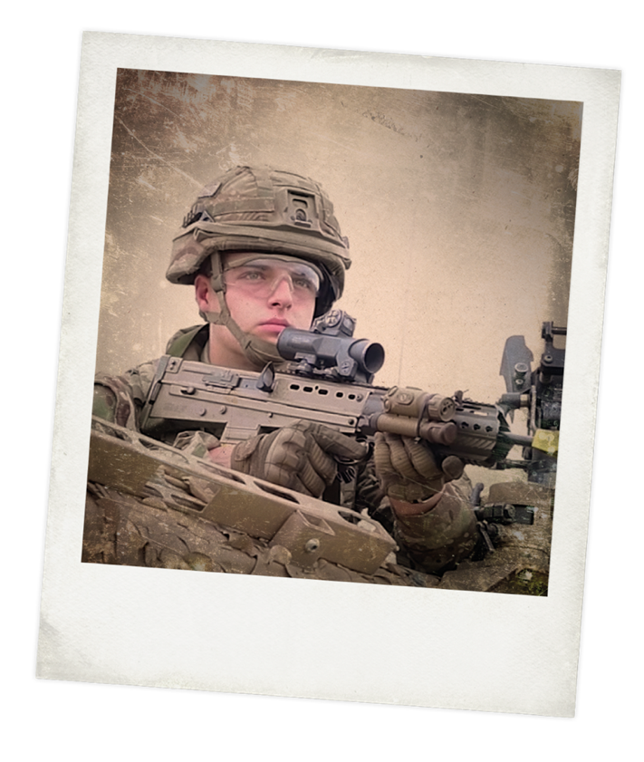
REAL-WORLD INTEGRITY
Integrity is one of the British Army’s six values and standards. Soldiers must always be honest, sincere, reliable and selfless. Soldiers must be loyal to the Army and be ready to do as it asks. The country relies upon it.
INTEGRITY | REAL-WORLD
Mission: Protect NATO military, civilian advisors and UK mentors based at the Afghan National Army Officers’ Academy
Location: Kabul, Afghanistan
The regiment were sent to Kabul to support the Afghan Government and security services.
Members of the British Army routinely work abroad in high pressured, unfamiliar environments. They must have respect and compassion for the people they meet, and use integrity to make the right decisions.
Notes:
Extension case study
Q. Why do you think integrity is one of the British Army’s key values?
Q. Members of the British Army are often in a position of responsibility. Why is it important for people in positions of responsibility to act with honesty, integrity and fairness?

Slide 14
THINKING ABOUT...INTEGRITY
1. My definition of integrity is:
3. Explain why your first choice is the most important way to act with integrity at school:
2. Which of these acts of integrity would have the most impact at your school?
Contributing equally to a group project
Not plagiarising or copying
Keeping your promises
Speaking out if you see injustices, e.g. bullying
Not talking behind someone’s back, e.g. on
social media
Not betraying a friend’s trust in you
Why?
INTEGRITY

