Slide 1
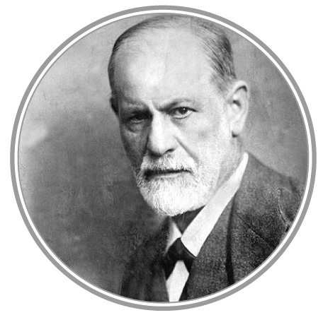
Important contributions/People in Psychology.
Brief History of Psychology.
Who are they and what did they do?
Which area of Psychology did they work in?
How does Psychology understand the Human Mind?

Slide 2
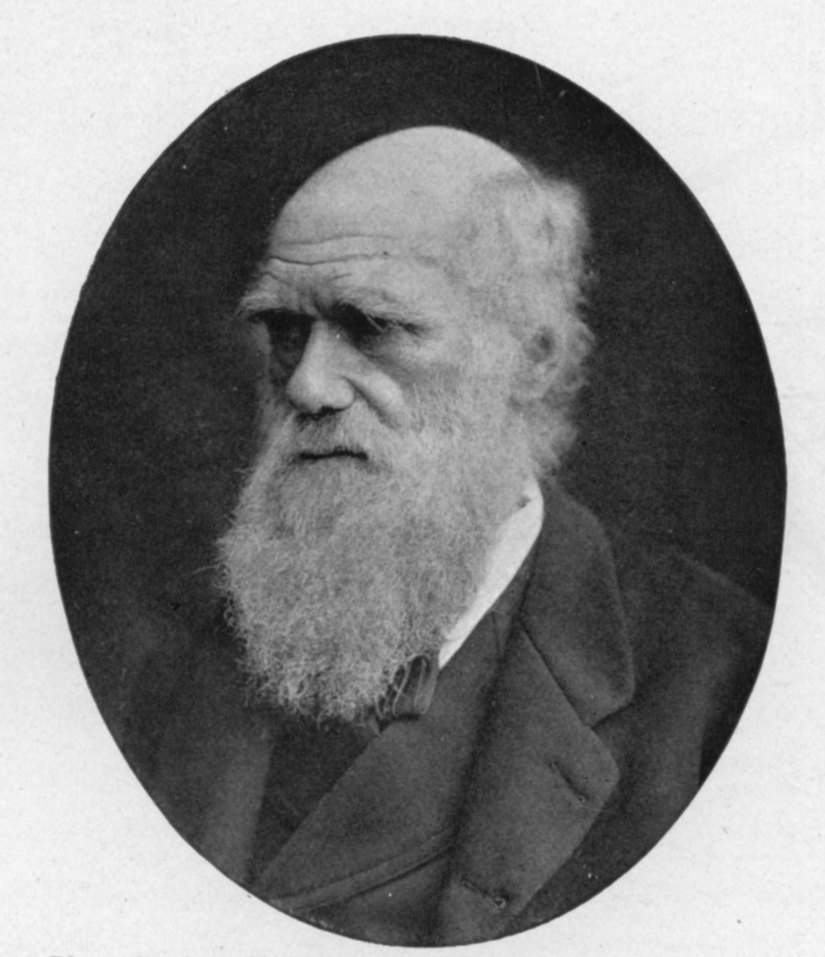
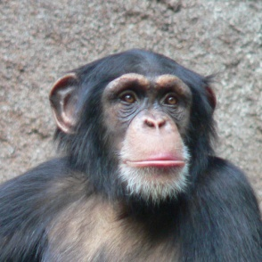
History of psychology.
During the 1800s Charles Darwin went on a five-year sea journey and noticed differences in animals around the world.
This inspired scientists to study animals to try and understand human behaviour.
Some animals brains are similar to human’s for example the chimpanzee.
Research on similar animals could be compared to humans.
This is still carried out today around the world but humans are a lot more complex.
Wilhelm Wundt is called the “father of psychology” because he set up the first lab. for studying humans in 1879.

Slide 3
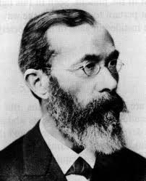
Wilhelm Wundt (1832 - 1920)
He wanted to take psychology out of philosophy and establish it as a science.
First scientist to set up a psychological laboratory.
Introspection: A method whereby the research analyses their own mental experiences under controlled lab settings.
Ask people what they feel.

Slide 4
Sigmund freud (1856-1939)
Born in Austrian in 1856. He came up with important theories of personality.
He was interested in how our personality develops, what can go wrong and how to “fix” it.
His theory was that we are influenced by things we are unaware of (unconscious conflicts) and also our early childhood experiences.
He beleived problems in adulthood can be traced back to early childhood.
Popular during 1950s but then declined until 1980s.
One of the first researchers in this field/area.
The Psychodynamic Theory was first talked about by Freud and looked at concious and unconcious desires.
Founder of Psychoanalysis.

Slide 5
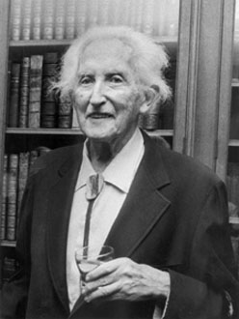
Erik Erikson (1902-1994)
Born in Germany in 1902. His theory says that personality is linked to a past psychological struggle.
He worked as a teacher in Europe.
Changed his last name from Homburger to Erikson to create his own identity.
He was interested in our identity and was the first to come up with the term “identity crisis”.
Created the “stages of psychosocial development.”
Like Freud he looked into our unconcious mind and used psychoanalysis.
His work helped to broaden the work Freud had already done with the psychanalytical theory.

Slide 6
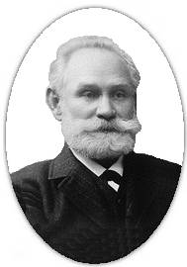
Ivan Pavlov (1849-1936)
Born in a small village in Russia in 1849.
Wanted to be a priest like his father before changing to science.
He read Charles Darwin's book “On the Origin of the Species.” This made him want to change jobs.
Looked at how we learn some types of behaviour. He called this conditioning.
Famous for his research into classical conditioning whilst working with dogs and other animals.
His early work on behaviourism was important and was used later by John B. Watson.
Was a scientist and did not like Psychology!

Slide 7
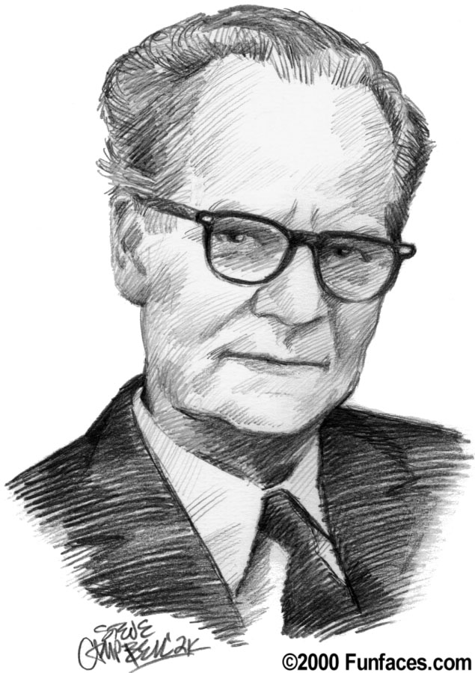
B.F. Skinner (1904-1990)
Born in America in 1904.
When he was young he enjoyed building and inventing new things.
He wanted to be a writer before he became a psychologist.
He was inspired by Pavlov and Watson’s writings and research.
He was a leader in the area of behaviourism.
Famous for his work on operant conditioning.
He also looked at NEGATIVE reinforcement and punishment for behaviour.
He believed that we are the way we are because of what we learn over years of life (eg. If we are treated nicely after doing something we will do it again).

Slide 8
Why are these people important?
Each person has studied a part of psychology for the first time.
Their work has led to more work by other people.
Over the years we are able to use their work to explain why we behave the way we do.
They have invented theories, ideas and approaches to psychology which are still useful today.

Slide 9
Complete extra research and reading about the important people from this PP.
Find out at least two extra interesting fact about each person that you did not learn in this PP.
Your fact can be anything about that person

