Slide 1
The Theme for your next project is STILL LIFE. You will need to go and find out what is meant by the term STILL LIFE.
This work will form part of your unit 1 coursework worth 60% of your final GCSE grade. Remember you will be marked on the quality and presentation of your work.
There are 3 different tasks in this PowerPoint that must be completed to be best of your ability. Make sure you read the requirements and criteria for each task carefully and go back and check at the end as the examiner will be looking and judging you on this criteria.
This work will be presented into your unit 1 book which so far contains your best work which all of you should be proud of. Therefore the presentation of this work is paramount and needs to be consistent with the presentation of your other folder work to date. GOOD LUCK!
STILL LIFE
Brief:
Many photographers have recorded Still Life in different ways. This can be achieved by careful selection and organisation of subject matter and techniques or by recording found objects. Keith Arnatt photographed rubbish, David Levinthal toys and Man Ray made photograms with Still Life Objects. Investigate still life photography and produce a personal response to this theme.

Slide 2
LO: to show your understanding of the brief by producing a thought shower and illustrating your ideas
Think of at least 20 keywords related to still life.
Think of anything in your house, anything inanimate, any “still” object.
Stick the work of the photographers and add a couple of keywords for each photographer you stick down. For example, if you stick Irving Penns photos, the two keywords could be: bold and found object

Slide 3
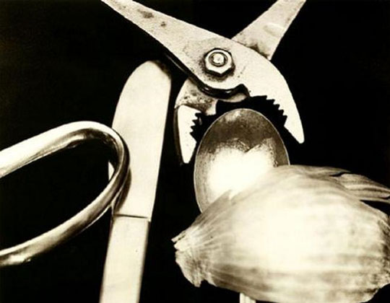
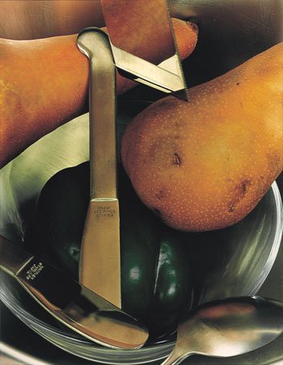
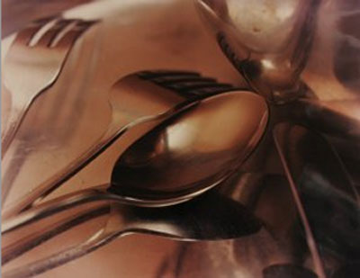
Jan Groover

Slide 4
Jan Groover

Slide 5
JAN GROOVER
(b. 1943, Plainfield, New Jersey) is an American photographer residing in Montpon-Menesterol, France, She is noted for her use of emerging colour technologies. Groover received a Bachelor of Fine Arts degree in 1965 from Pratt Institute, and a Master of Arts in 1970 from Ohio State University. She has been the subject of a short film by the photographer Tina Barney, (Jan Groover: Tilting at Space, 1994)
Resources 1-
Jan Groover abandoned painting for photography and puts a painter’s sense of composition into her series of photographic Kitchen Still Lifes. Groover uses the reflection off the metals of her cutlery and steel bowls to give off painterly effects of light and dark, and shadow. The photos are cropped close-ups of a mix of utensils and produce, often larger than life. Groover sometimes incorporates mirrored elements to further increase the depth of the usually simple objects. Groover has been compared to Cezanne, in that she creates incredible images from what are seemingly insignificant objects arranged on a table in her studio.
Resources - 2 Jan Groover is well known for her formalist still life photographs of household utensils. Groover was born in Plainfield, New Jersey in 1943. She attended Pratt Institute in Brooklyn, New York and graduated in 1965 with a bachelor of fine arts in painting. Groover taught art in public school before enrolling in a master of fine arts program for art education at Ohio State University. Before she developed an interest in photography, Groover devoted much of her time to painting minimalist abstractions. After completing her masters degree she accepted a teaching position at the University of Hartford in Connecticut. She then started to take up photography instead of painting. Groover stated, With photography I didn’t have to make things up, everything was already there.
Groover started creating her first photographs in the late 1970s. These were color diptychs and triptychs depicting vehicles in motion. They were formalist images emphasizing time, distance, speed, and color. When the vehicle was close to the camera the object was blurred and when the vehicle was farther away from the camera the object was sharper. In Groover’s motion studies color played an important role in enhancing the depth of the moving object.
In 1978 Groover turned to her kitchen sink for new ideas. She completely changed the subject matter of her photographs, moving from street scenes out-of-doors to still lifes of household objects. She chose as her subjects familiar, everyday objects she could arrange any way she wanted. She did not have to rely on natural lighting, but was able to illuminate her subjects with artificial lighting. Groover took large color close-ups of objects like stainless-steel utensils, spoons, forks, knives, whisks, spatulas, bowls, glass dishes, red and green peppers, and houseplants. She experimented with combinations of objects until a relationship of shapes, colors, and spaces pleased her. Her pictures were taken with a 4x5 view camera and enlarged as 16x20 inch prints.
Groover’s approach to her still lifes was a formalist approach. Formalism is everything, she commented. Groover looked at the objects in her still lifes for their shapes, lines, colors, and textures. Sometimes it is difficult to recognize if the objects are in the foreground, middle ground, or background. According to Groover, the meaning of the objects is of no importance; only the shape, texture, and form that falls into a particular space is important. According to one writer, Groover makes pictures that are interesting not so much for the things they show us as for how they show us these things

Slide 6
Jan Groover
In art theory, formalism is the concept that a work's artistic value is entirely determined by its form—the way it is made, its purely visual aspects, and its medium. Formalism emphasizes compositional elements such as color, line, shape and texture rather than realism, context, and content.
What does she do?
How does she do it?
Any insight on her work?
Any quote?
Any difficult words?
LO: learn to demonstrate your understanding of the artist’s work
Using the Images and research provided, do a presentation page including:
A) Title – Artist name
B) Facts about the artist ( few short facts )
C) Pictures of the artist’s work

Slide 7
Lo: to understand the work of Jan Groover by analysing a photograph
Produce a double page on Jan Groover’s work –Using the information and pictures provided, you need to include: a title, keyfacts, photos of her work and analysis of one photograph
ANALYSIS
What do the shape remind you of? Can you think of an art movement where the artist uses sections of objects in their work?
How would you describe the shapes?
What can you say about the light and colours of the objects?
Can you think of other keywords to best describe Jan Groover’s work? Think of at least 6

Slide 8
Jan Groover photoshoot Due 20th June 2020
Take a minimum of 20 photos inspired by the work of Jan Groover.
Using cutlery try and take as many macro shots as possible
Think about:
-Composition
-reflection
-macro
-creating interesting shapes
TOP TIP – Try and use the camera to frame interesting shapes rather than capturing the actual objects. Jan Groover rarely if ever would include the whole of the objects in these shots but rather just captures parts of them in various positions to create interesting compositions.

Slide 9
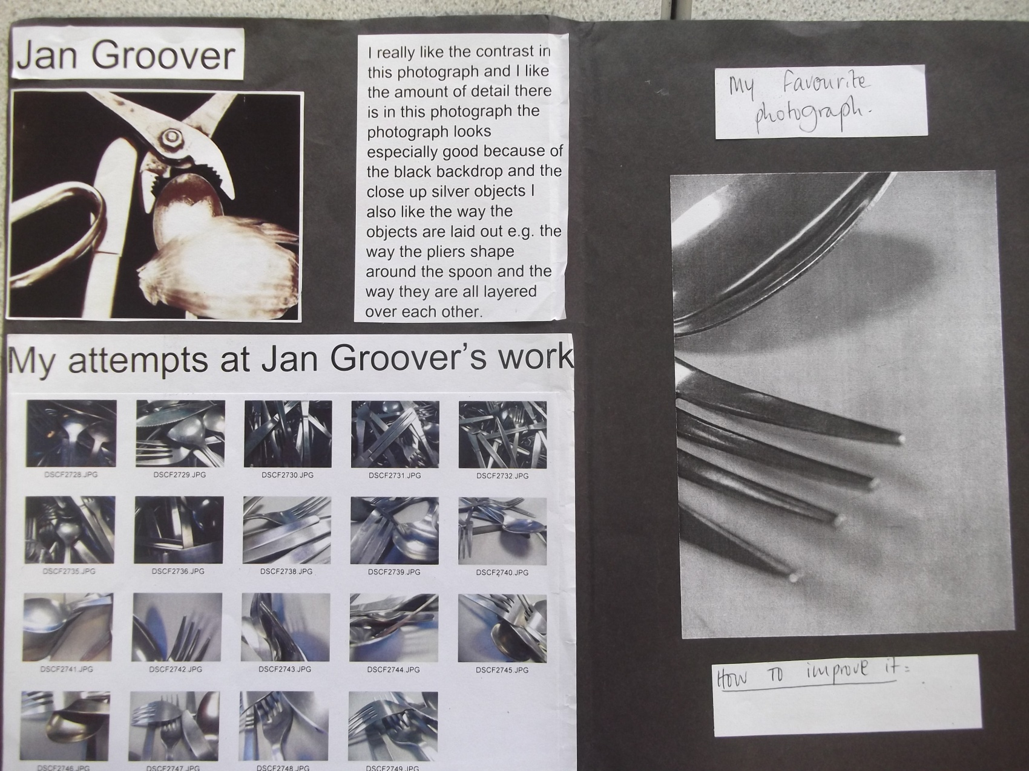
Here is an example of how another student has presented their images. Notice how it includes a personal evaluation and clearly shows there understanding of the photographers work in a visual way

