Slide 1
The Reward Shop
R1
R3
R4
R2

Slide 2
Every time you receive a R1, R2 or R3 you receive points that can be exchanged for rewards!!!
R1 - 1 point
R2 - 5 points
R3 - 20 points
R4 - 40 points

Slide 3
Every time a member of staff rewards you they will record it in CLASS CHARTS. All of your points are added together for you to spend on rewards.
Although you must remember that every time you receive a sanction your reward points will be deducted!
How does it work?
1- You will all be given a CLASS CHARTS code that you will use to log in to your class charts account.
When Can I Collect?
2- In the rewards section of CLASS CHARTS you will see all the rewards that are on offer.
You’ll have a designated time and place to collect your rewards every week. Your form tutor will tell you about this when you join us!
3- Select the items that you would like to order.
4- Collect what you have ordered from the reward shop on the day that it is open.

Slide 4
What’s on offer?
There are lots of things on offer. The more point you earn the better the rewards get! Take a look….

Slide 5
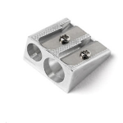
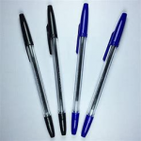
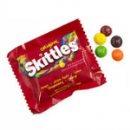
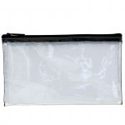
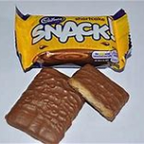
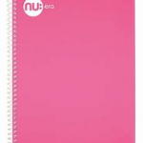
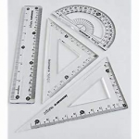
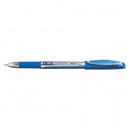
10
Mentos
15 points
Mechanical pencil
15 points
Sharpener
10 points
Moam bloxx
15 points
Eraser
10 points
Mini cheddars
15 points
Folding ruler
15 points
Raisins
15 points
Black/blue biro
5 points
Small dairy milk
25 points
Fruit winder
15 points
Clear pencil case
20 points
Small bag of skittles
20 points
Cereal bar
15 points
Fruit and biscuit
shots
15 points
Small snack biscuit
15 points
Small bag of cookies
20 points
Geometry set 25 points
Gel pen
30 points
Chewits
30 points
Gold and silver gel pens
35 points
A5 pink and green note book
35 points
2 finger kit kat
25 points
Neon gel pens
35 points
Sweet popcorn
35 points

Slide 6
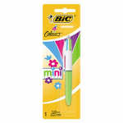
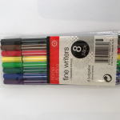
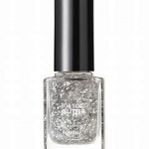
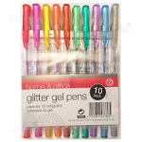
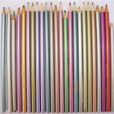
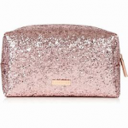
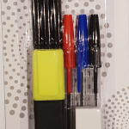
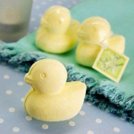
40 – 65
points
Small 4 colour pen
40 points
Small pot of pringles
45 points
Fine liner pens
45 points
Small bag of Doritos
45 points
Nail varnish
45 points
Bath fizzer
45 points
Metallic pencils
45 points
Make up bag
50 points
Oreo biscuits
45 points
Maryland cookies
45 points
Glitter gel pens
50 points
Oreo sandwich chocolate bar
55 points
Galaxy cookie crumble chocolate bar
55 points
Stationary set
65 points
Cadburys cookies
65 points
Chunky cookies
65 points
Chocolate fingers
65 points
Duck bath bomb
65 points

Slide 7
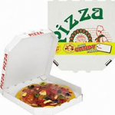
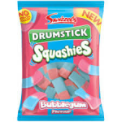
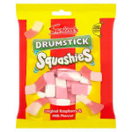
Chupa Chup pizza
70 points
1 bag of sweets or chocolate 75 points
70 – 85
points
Skip to the front of the queue pass
80 points
Oxford geometry set
85 points

Slide 8
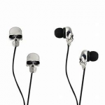
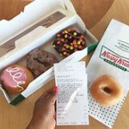
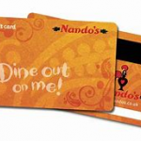
Skull earphones
120 points
Teddy bear earphones
120 points
Football
200 points
£10 Playstation gift card
500 points
£10 X BOX Gift card
500 points
£10 Amazon gift card
500 points
120 – 700
points
£15 I tunes gift card
700 points
3 Krispy kremes
500 points
£10 cinema gift card
500 points
£10 Nandos gift card 500 points

