Slide 1
BELIEFS AND TEACHINGS
Christianity

Slide 2
Key Beliefs : The Nature of God
L/O:
To appreciate that God is omnipotent, loving and just. To consider the problem of evil and suffering.

Slide 3

Basic Christian beliefs
There is one God
God is all powerful
God loves each one of us
We should love and care for each other
We should love God
Jesus is God’s only Son
Jesus died to save us from our sins
Jesus helps us to know God better
The Holy Spirit stayed around us
after Jesus went back to heaven

Slide 4
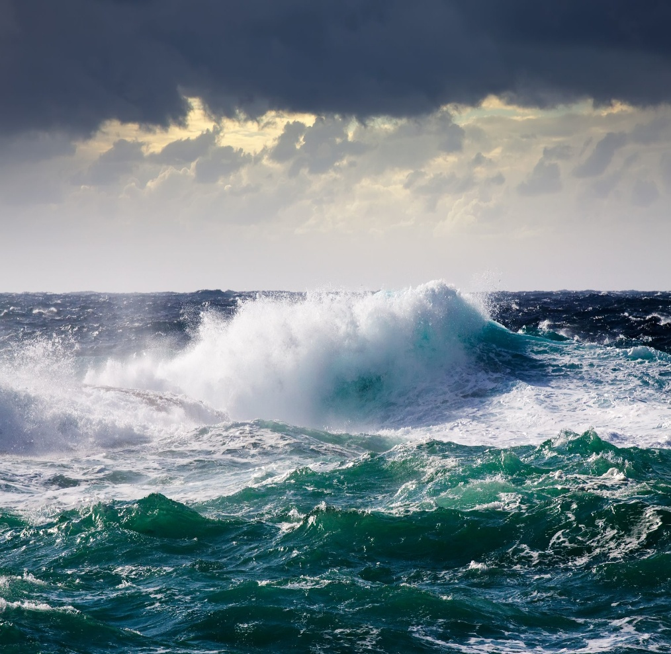
Omnipotent
God as omnipotent
What does the bible say about God’s omnipotence.
The Creation
The Flood
Ten Plagues
Calming of the Storm

Slide 5
Key Questions
What is meant by omnipotence?
How might Christians claim God has shown his omnipotence?
What is meant by all-loving, and agape?
Explain how God is all-loving?

Slide 6
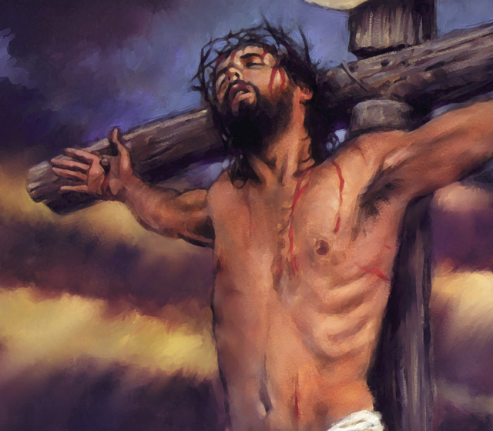
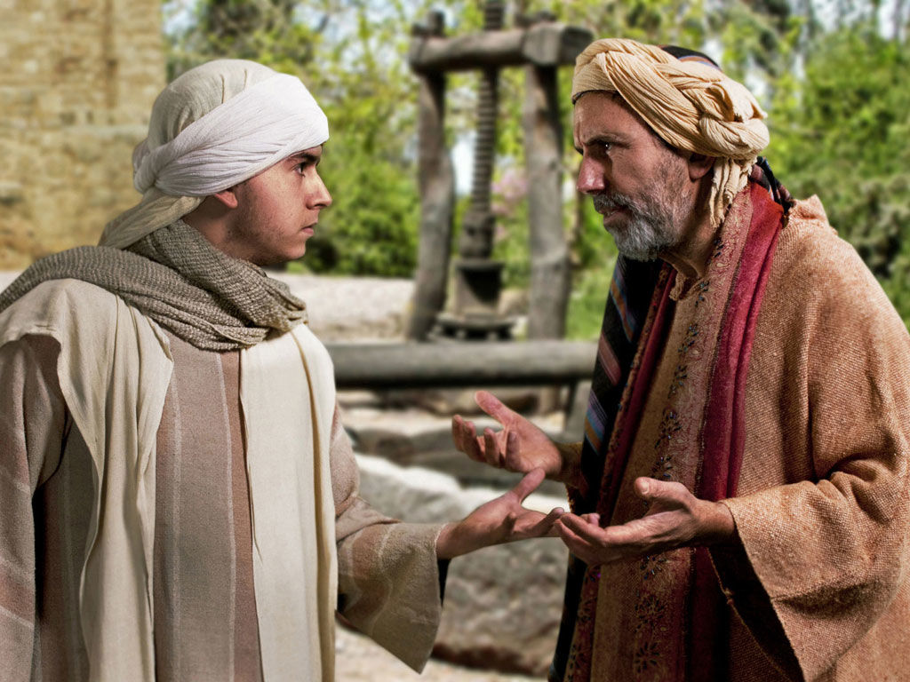
Agape
God as loving.
How God’s all loving nature is shown in the Bible

Slide 7
Key Questions
Think about events that happen in the world. Make a table and list of those that might show God as loving and one of those that might suggest God is not loving. Make a table and list to show God’s power, or non-power.
Extension for each one explain your reasons for your decisions

Slide 8
All suffering can be used to show God’s love.
Do you agree with that statement? Explain your answer.

Slide 9
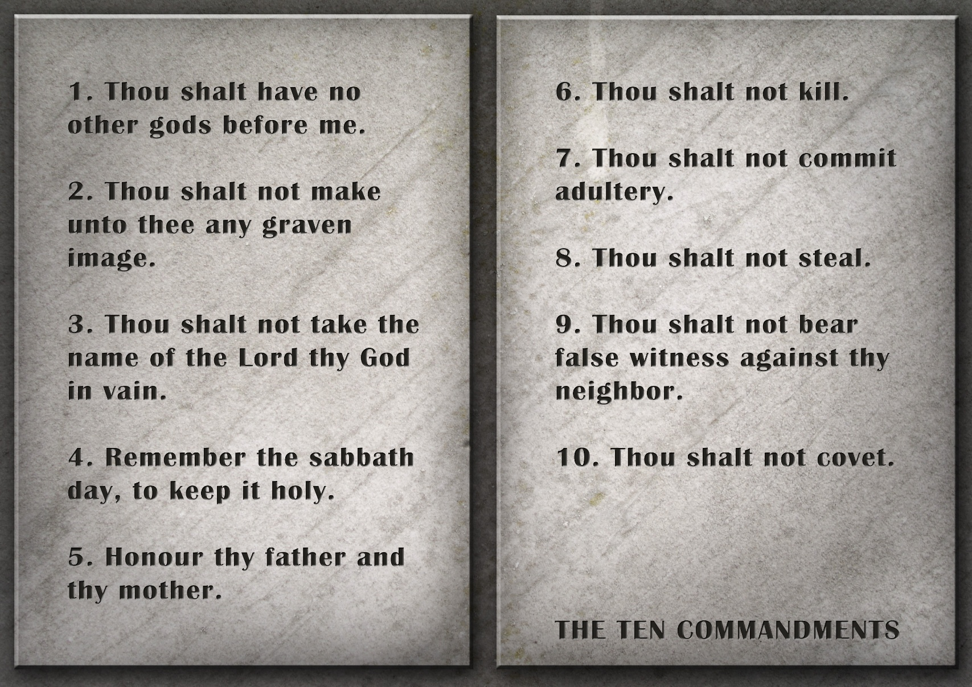
God is Just

Slide 10
Key Questions
What do Christians mean when they say God is just?
How might Christians reflect this belief in justice in their lives?
Explain, giving two reasons for each, why some people think that God is not loving and not just.
Explain how Christians might argue against these views

Slide 11
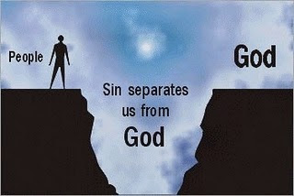
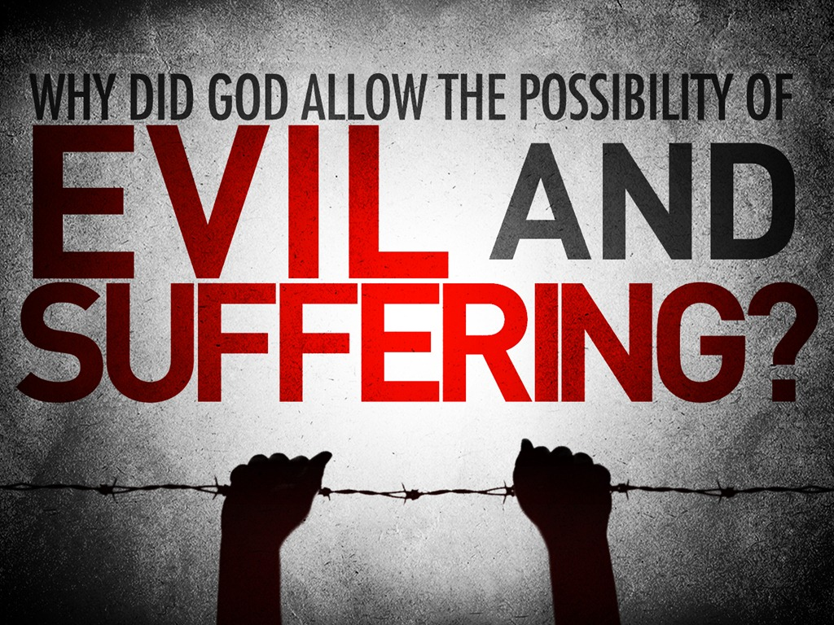
The problem of evil and suffering

Slide 12
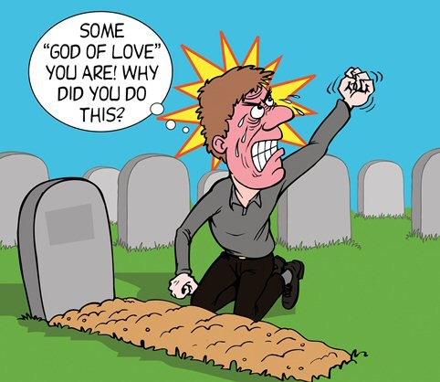
Key Questions.
What is the problem of evil?
How do Christians explain the existence of evil and suffering?
It is impossible for God to be all-loving and allow evil and suffering. Do you agree? Explain your arguments.

Slide 13



Key Beliefs : The Nature of God
L/O:
To appreciate the oneness of God. The Trinity Father, Son and Holy Ghost.

Slide 14
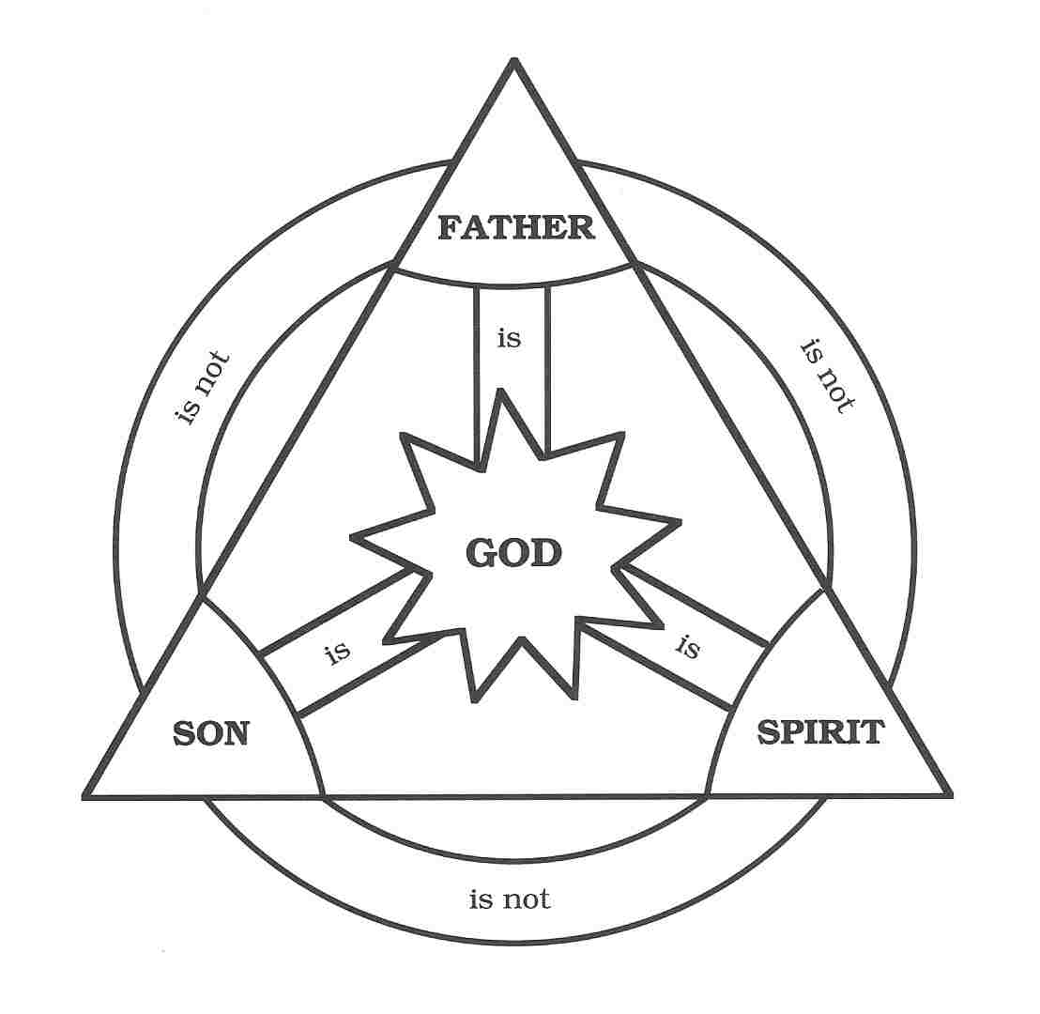
Explain the Christian belief in the Trinity.
Explain how believing in the Trinity might influence a Christian’s life.
Christians believe in three gods, not one. Do you agree? Explain your reasons.

Slide 15
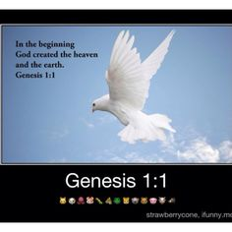
Key Beliefs : Different Christian Beliefs about Creation
L/O:
To understand the concept of creation – the Word and Spirit.

Slide 16

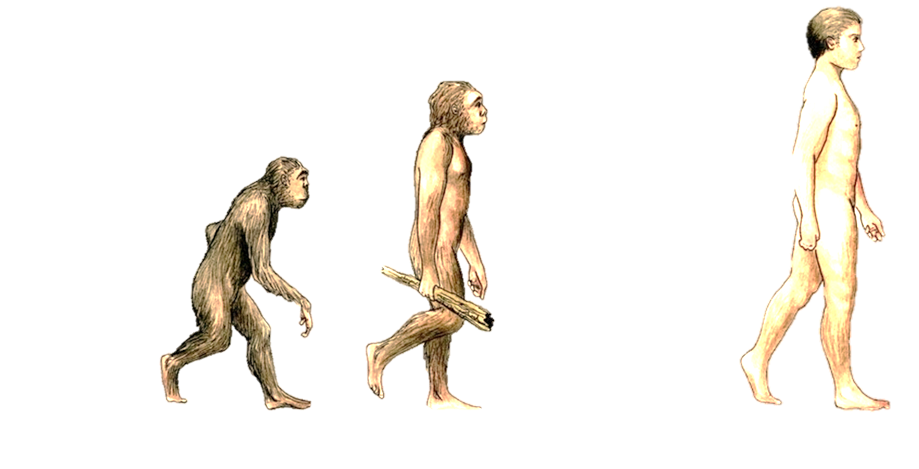
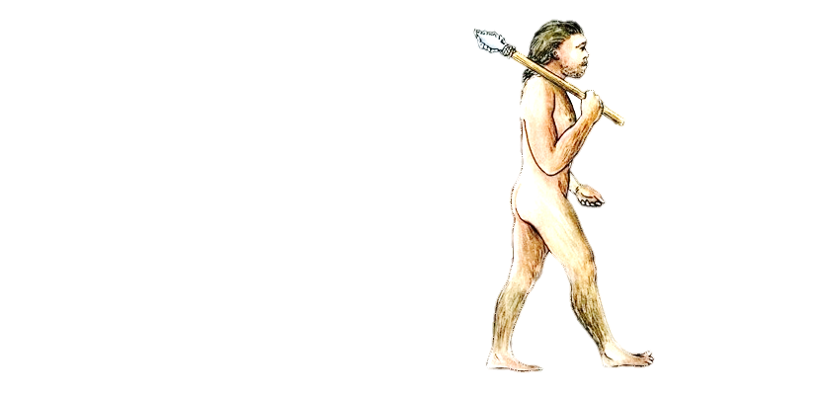

Christian teachings about how the world began and everyone who lives here
Learning objectives:
Investigate Christian ideas about how the world began.
Examine biblical teaching about the beginning of humankind.
Weigh up Creationist’s views of the creation story from Genesis.

Slide 17
Key Word Definitions
Creationist
The doctrine that God immediately creates out of nothing a new human soul for each individual born.
Atheist
A person who denies or disbelieves the existence of a supreme being or beings.
Agnostic
A person who denies or doubts the possibility of ultimate knowledge in some area of study.
Theist
The belief in one God as the creator and ruler of the universe, without rejection of revelation

Slide 18


Starter
How did the world begin?
What do you think?
Is your view atheist, agnostic or theist?
5 minutes

Slide 19
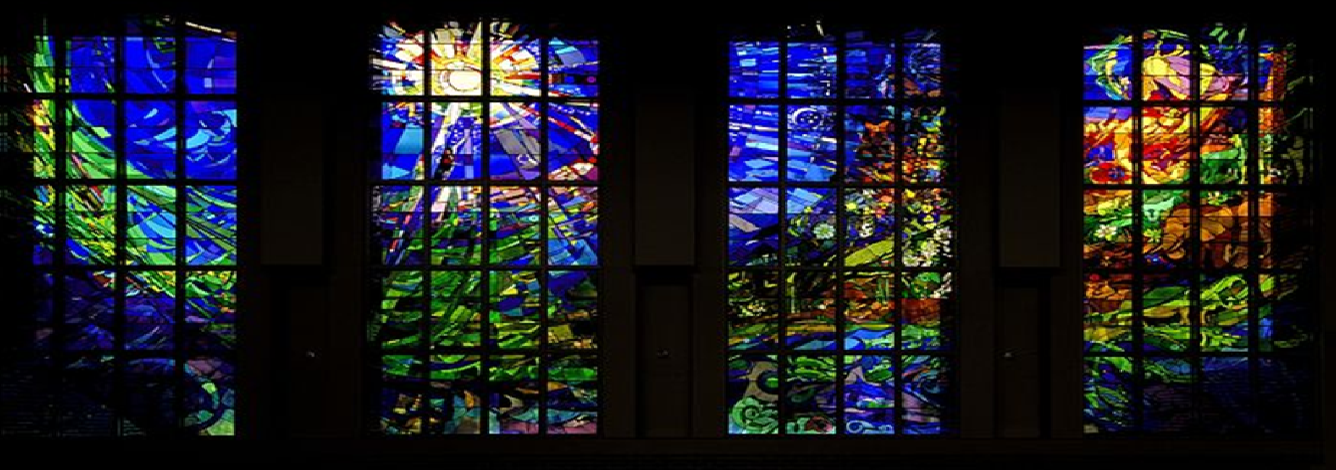


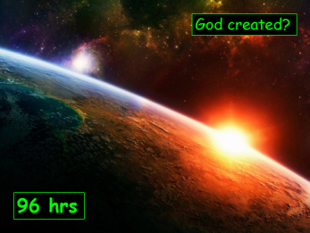
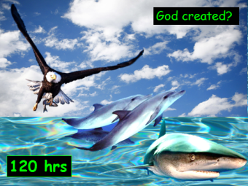
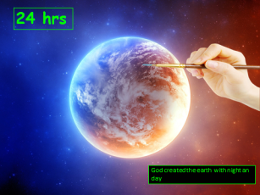
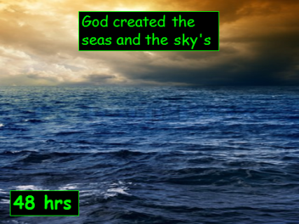
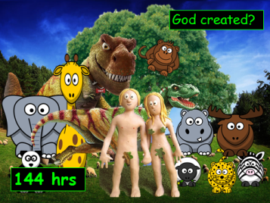
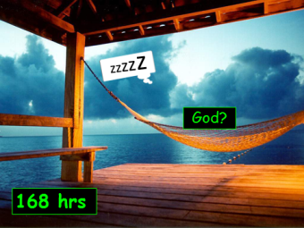
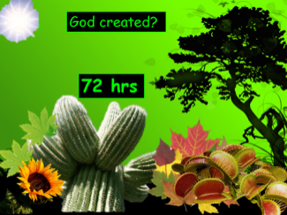

Genesis means beginning
Creationists believe the bibles events of the creation of earth.

Slide 20
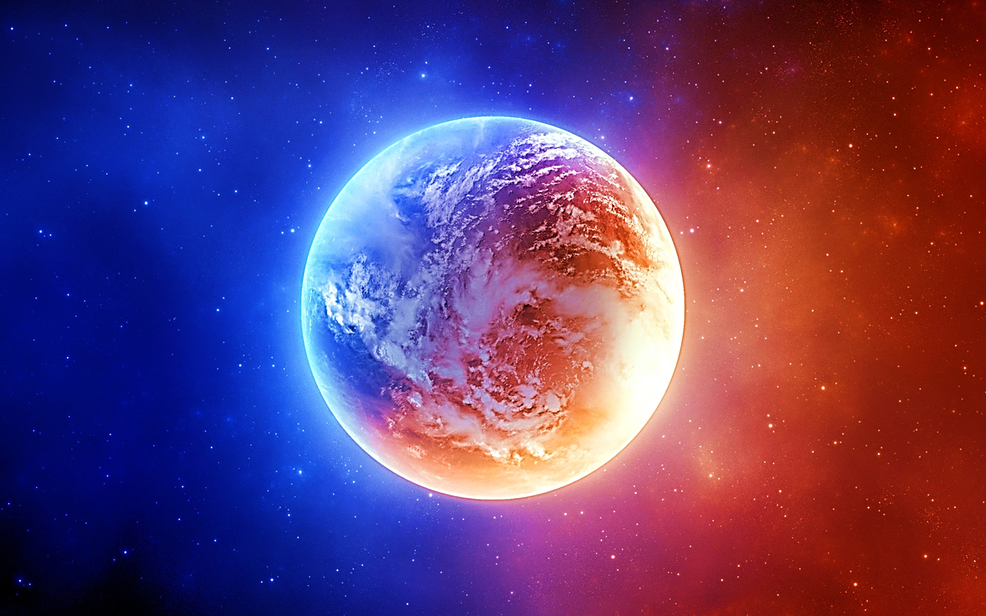

24 hrs
God created the earth, night and day.

Slide 21

God created the sea and the sky
48 hrs

Slide 22







72 hrs
72 hrs
God created all kinds of plant life

Slide 23

God created the sun and stars
96 hrs

Slide 24


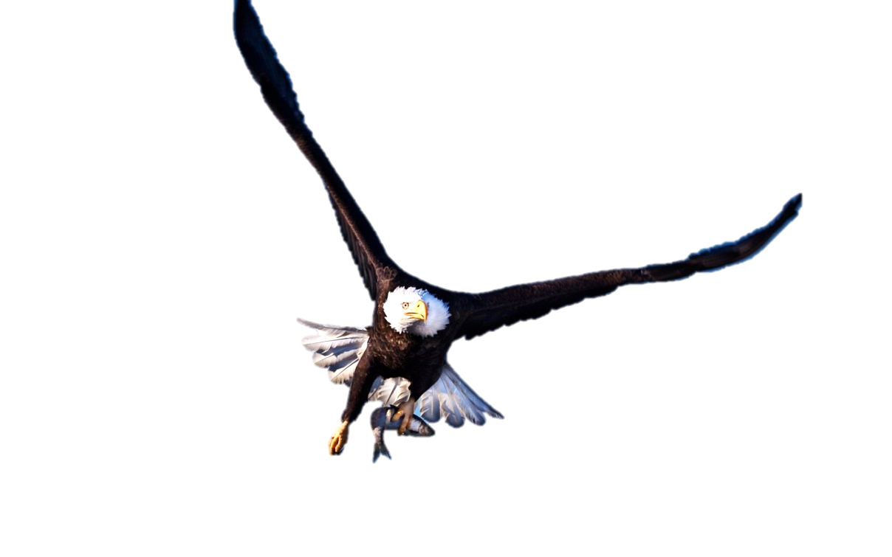
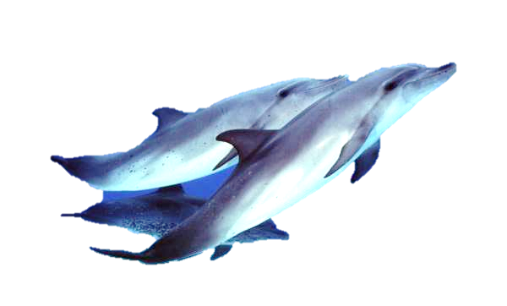

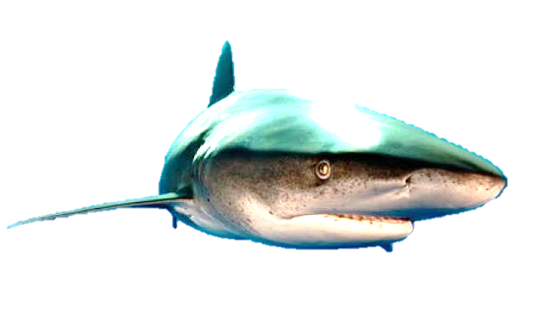
God created fish and birds
120 hrs

Slide 25

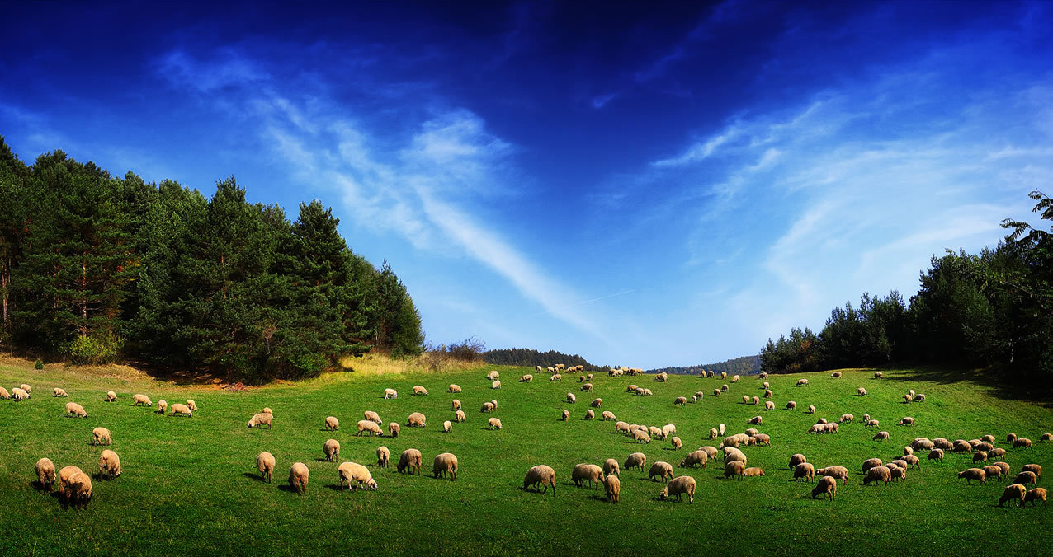
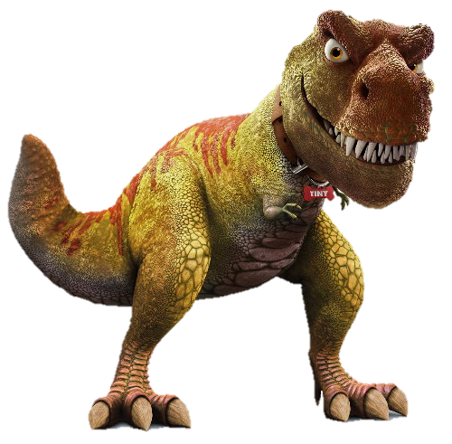


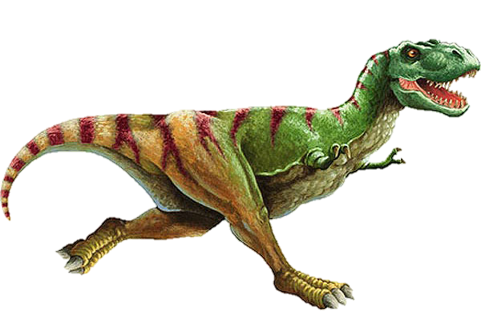
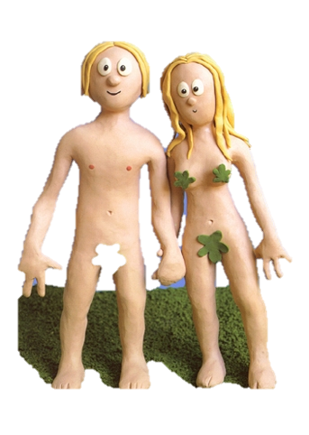







God created all of the animals and Adam and Eve
144 hrs

Slide 26


168 hrs
zzzzz
God rested and made the seventh day holy

Slide 27
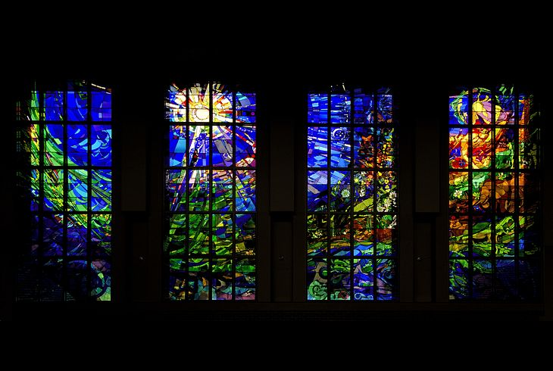




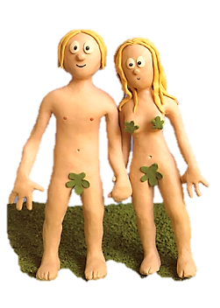

For Christians the bible is Gods word, so the story in Genesis is taken literally and can be seen as factual by some Christians.
In the beginning…………………………………..
creationist

Slide 28

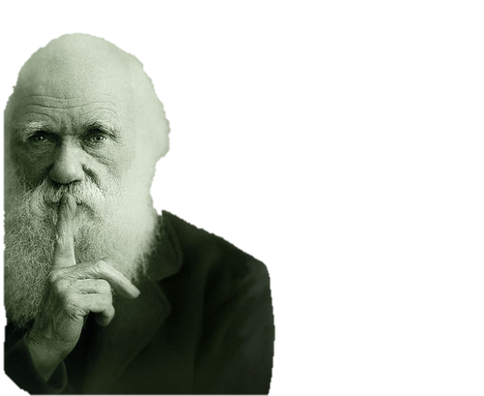

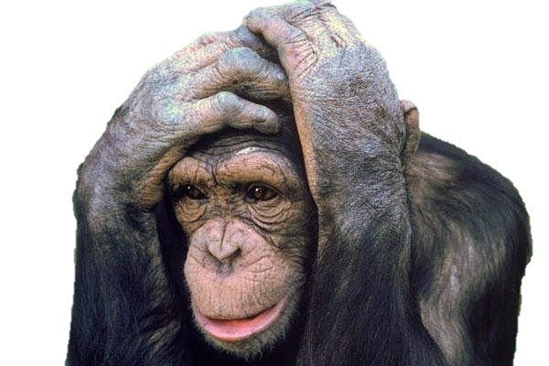
Creationist views
Creationists believe that the world is very young. And can date the event of Genies to 6000 years ago
Earth | 6 | 0 | 0 | 0 | Years old

Slide 29
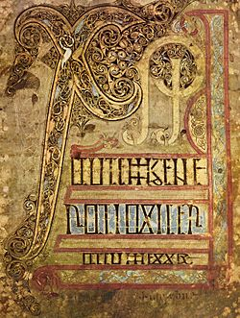
For other Christians though
It was a story told orally from generation to generation to people to explain our existence in the pre scientific age?

Slide 30
The origins of humanity
Genesis 1:27-28
The Message (MSG)
²⁶⁻²⁸ God spoke: “Let us make human beings in our image, make them
reflecting our nature
So they can be responsible for the fish in the sea,
the birds in the air, the cattle,
And, yes, Earth itself,
and every animal that moves on the face of Earth.”
God created human beings;
he created them godlike,
Reflecting God’s nature.
He created them male and female.
God blessed them:
“Prosper! Reproduce! Fill Earth! Take charge!
Be responsible for fish in the sea and birds in the air,
for every living thing that moves on the face of Earth.”
Genesis 1

Slide 31
The origins of humanity
Adam and Eve
⁵⁻⁷ At the time God made Earth and Heaven, before any grasses or shrubs had sprouted from the ground—God hadn’t yet sent rain on Earth, nor was there anyone around to work the ground (the whole Earth was watered by underground springs)—God formed Man out of dirt from the ground and blew into his nostrils the breath of life. The Man came alive—a living soul!
⁸⁻⁹ Then God planted a garden in Eden, in the east. He put the Man he had just made in it. God made all kinds of trees grow from the ground, trees beautiful to look at and good to eat. The Tree-of-Life was in the middle of the garden, also the Tree-of-Knowledge-of-Good-and-Evil.
¹⁰⁻¹⁴ A river flows out of Eden to water the garden and from there divides into four rivers. The first is named Pishon; it flows through Havilah where there is gold. The gold of this land is good. The land is also known for a sweet-scented resin and the onyx stone. The second river is named Gihon; it flows through the land of Cush. The third river is named Hiddekel and flows east of Assyria. The fourth river is the Euphrates.
¹⁵ God took the Man and set him down in the Garden of Eden to work the ground and keep it in order.
¹⁶⁻¹⁷ God commanded the Man, “You can eat from any tree in the garden, except from the Tree-of-Knowledge-of-Good-and-Evil. Don’t eat from it. The moment you eat from that tree, you’re dead.”
¹⁸⁻²⁰ God said, “It’s not good for the Man to be alone; I’ll make him a helper, a companion.” So God formed from the dirt of the ground all the animals of the field and all the birds of the air. He brought them to the Man to see what he would name them. Whatever the Man called each living creature, that was its name. The Man named the cattle, named the birds of the air, named the wild animals; but he didn’t find a suitable companion.
²¹⁻²² God put the Man into a deep sleep. As he slept he removed one of his ribs and replaced it with flesh. God then used the rib that he had taken from the Man to make Woman and presented her to the Man.
²³⁻²⁵ The Man said,
“Finally! Bone of my bone,
flesh of my flesh!
Name her Woman
for she was made from Man.”
Therefore a man leaves his father and mother and embraces his wife. They become one flesh.
The two of them, the Man and his Wife, were naked, but they felt no shame.
Genesis 2

Slide 32
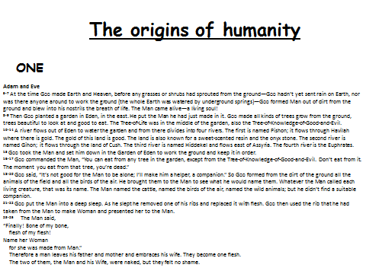
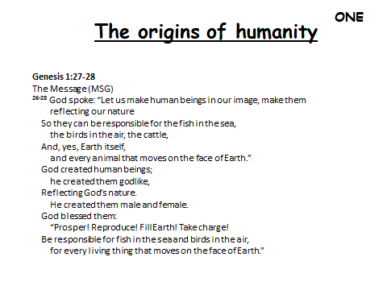
Exercise 3
Read the two accounts of creation from Genesis. In pairs can you identify any differences?
Highlight the differences and explain why you think this is? Cut the 2 texts out and neatly stick them into books.
ONE INTERPRETEATION OR MANY MASK ACTIVITY –LINK TO 2 DIFF VERSIONS OF CREATION

Slide 33
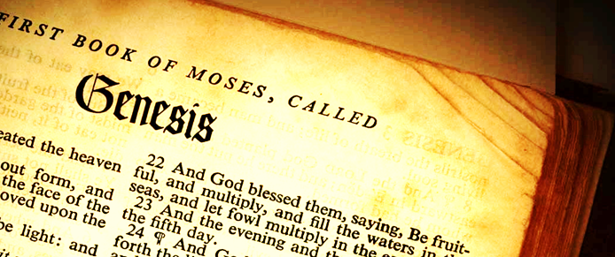

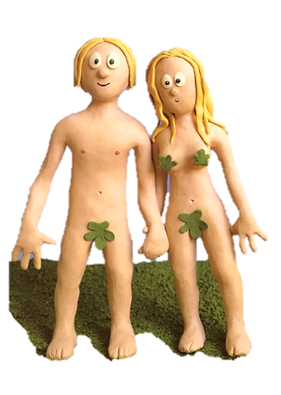
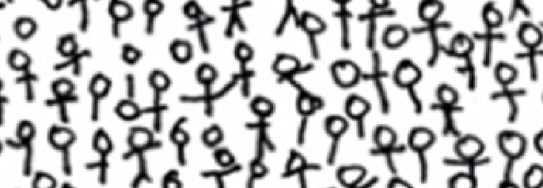

The origins of humanity
Creationists believe that God created man in his own image; in the image of God he created him; male and female he created them.’ Genesis
Genesis 2 gives more detail about the creation of humanity. Saying that God made Eve from Adams rib bone.
These are the 2 people from whom everyone is descended and are not related to animals.

Slide 34
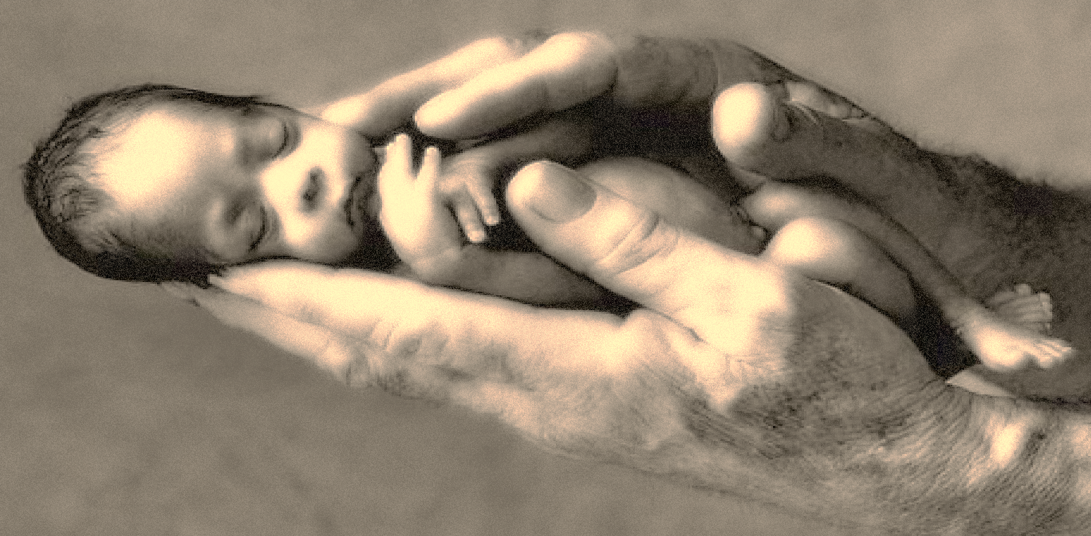

The origins of humanity
Other Christians dismiss the stories from Genesis as myths that have been handed down from ancestors. They believe there is no science in it and it is simply telling people about their relationship with God.
Other Christians believe that God created people to be like him so they have a special relationship with their creator but that Adam and Eve and the Garden of Eden is not factual.

Slide 35
Christian beliefs about creation
Why is God called the Father? What is the role of the Father?
Explain how the three Persons of the Trinity were all part of the creation (clue – you will need to refer to each of the three parts)
The Trinity is the most important belief in Christianity. Explain arguments to agree and disagree with this.

Slide 36
Key Beliefs : Different Christian beliefs about the after life and their importance
L/O:
To understand Resurrection and after life of Jesus. Judgement, heaven and hell

Slide 37
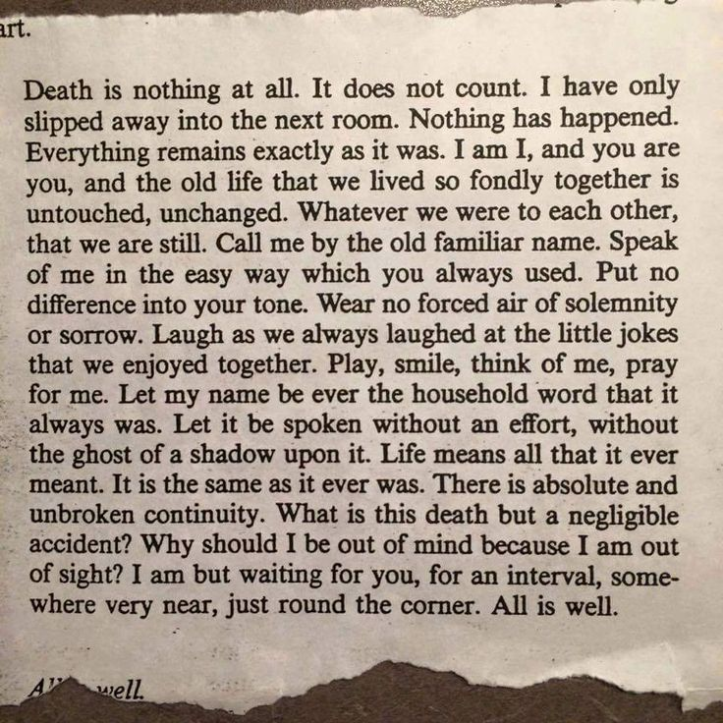

Slide 38
Key Questions
What do people mean when they talk about the after life?
Look at the poem. What do you th it means?
Explain why many people believe in an afterlife.

Slide 39
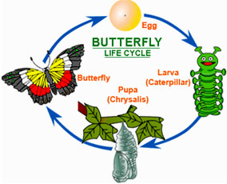
What Christians mean by resurrection

Slide 40
Key Questions
What is a creed? Name two Christian creeds.
Explain what Christians man by “resurrection”.
Evaluate the claim that belief in life after death makes no sense. Try to give reasons for and against this statement

Slide 41
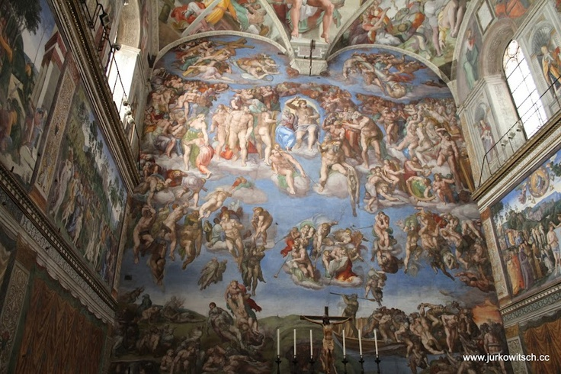
Last Judgement
Explain the Christian belief about judgement.
It makes sense for everyone to live as if they believe in a Judgement Day. How far do you agree with this statement? Explain reasons for and against it.

Slide 42
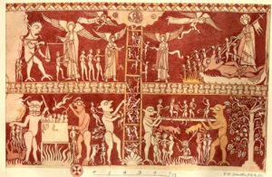
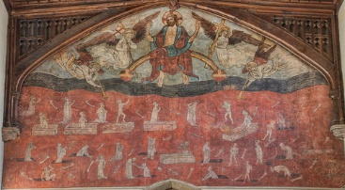
Doom Painting

Slide 43
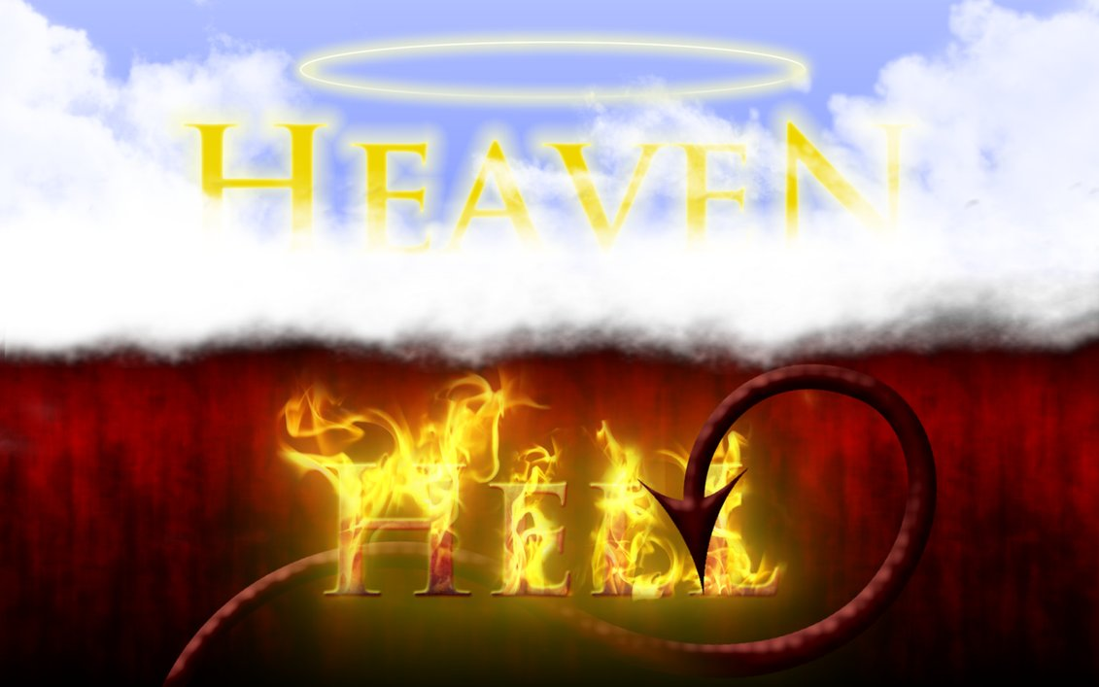
Describe Christian ideas of heaven and hell.
Explain why Christians might find themselves in heaven or in hell after death.
The existence of hell do not fit with a belief in an all-loving God. Agrue for and against this statement

Slide 44

Jesus Christ
L/O:
To understand the Beliefs and Teachings about the incarnation and Jesus as the Son of God.

Slide 45
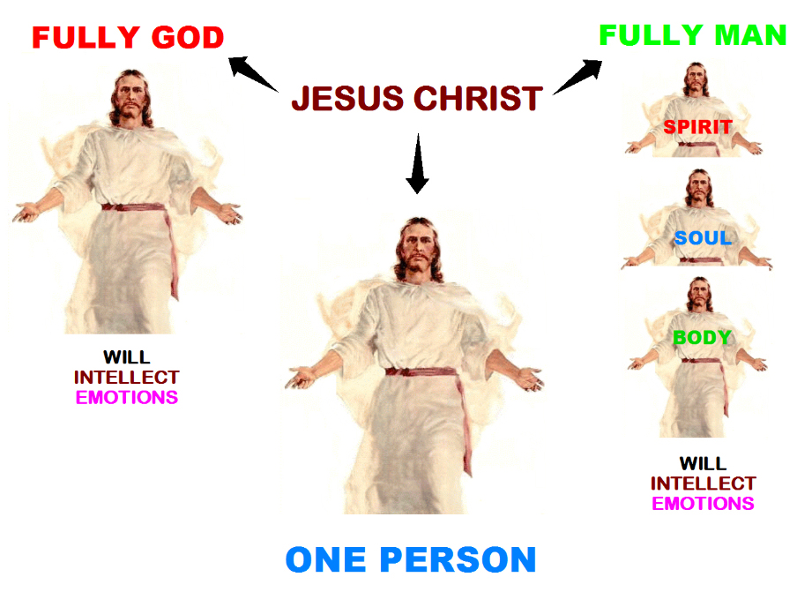
The incarnation – Jesus the Son

Slide 46
Key Questions
What does incarnation mean?
Look at John 1:14 quote what does it mean?
What does the Bible tell us about the birth of Jesus?
It is easy to believe the story of the Virgin Birth. Do you think this statement is true? Explain your reasons to agree and disagree. Include what Christians might say.

Slide 47
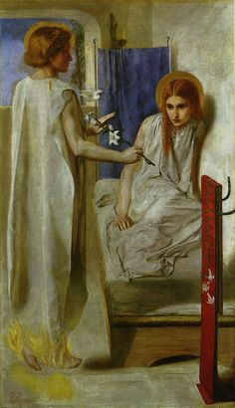
Rosetti Ecce Ancilla Domini

Slide 48
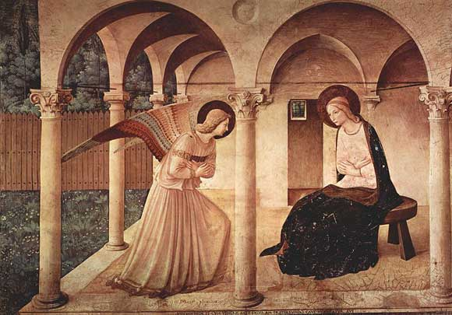
Fra Angelico

Slide 49
The person of Jesus Christ
L/O:
To understand the Beliefs and Teachings about the crucifixion.

Slide 50
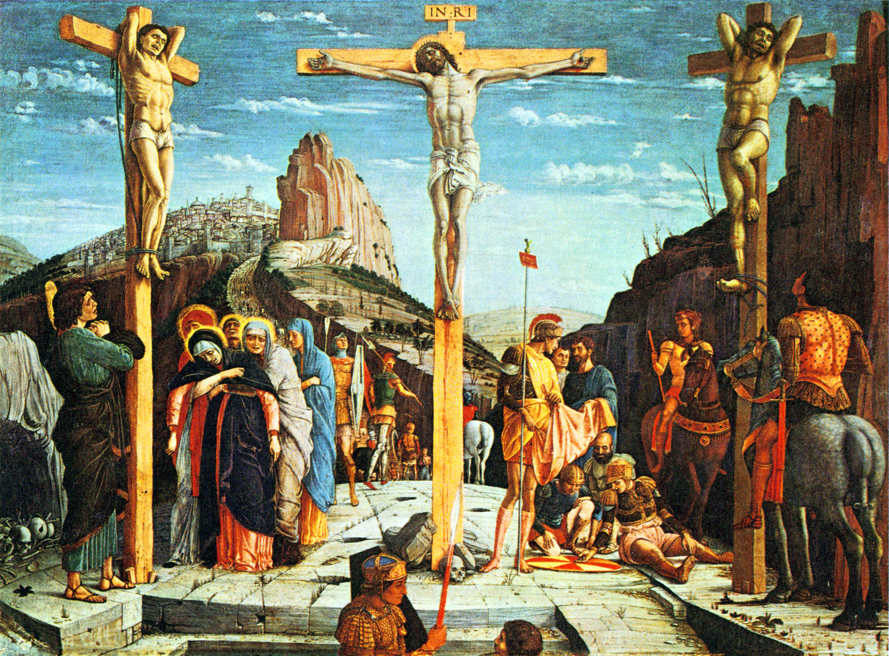
The Crucifixion

Slide 51
Tribunes and triumphs website - Roman Crucifixion
Bible Archaeology website - Crucifixion

Slide 52
Key Questions
Describe the events leading up to Jesus’ death.
Describe the events of the Jesus’ crucifixion.
Why is the crucifixion important to Christians?
Why do you think Jesus felt “forsaken”?
If Jesus died to help us it is the greatest sacrifice ever made. How might you agree with this statement?

Slide 53
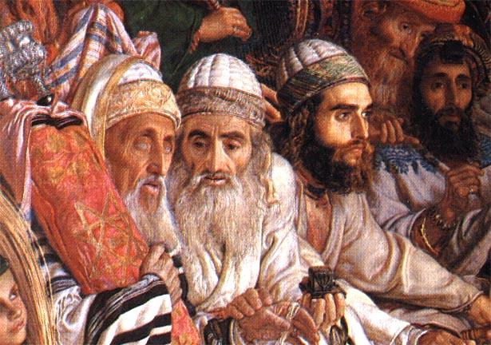
Why did the Son of God have to die?
Explain why the Sanhedrin wanted Jesus dead.
Explain how and why Pilate was responsible for Jesus’ death.
No one was to blame for the death of Jesus. What do you think? Explain your reasoning.

Slide 54

The person of Jesus Christ
L/O:
To understand the Beliefs and Teachings about the resurrection and ascension

Slide 55

Key Questions
What happened after Jesus had been crucified?
Read Luke 24:13 – 35. Either write an account of the story, as if you were Cleopas, or draw a comic strip cartoon with the title: The Journey to Emmaus.
Describe the ascension.
The ascension is just a made up story to show Jesus was special. Explain reasons for and against this statement, including what Christians might say.

Slide 56
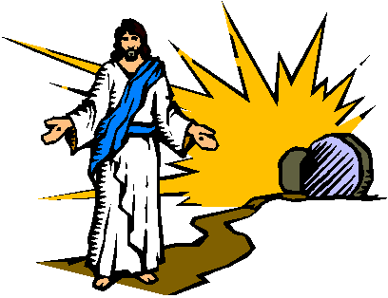
Key Questions
Why is the resurrection important for Christians?
How might believing in the resurrection affect the way people live their lives?
Using the information in the table, evaluate the claim that ‘Jesus’ resurrection is a lie.’

Slide 57
The person of Jesus Christ
L/O:
To understand the Beliefs and Teachings about original sin and salvation including atonement.

Slide 58

Key Questions
Explain what is meant by the terms original sin and salvation.
Some people think that God set Adam up to fail. What do you think they mean by this?
Explain how different Christians have believed that human can earn a good relationship with God.

Slide 59

Key Questions
What are meant by reconciliation and atonement?
Explain how Christians believe human beings had separated themselves from God and how God addressed that problem.
Christians should be prepared to follow Jesus even to death. Explore and analyse this statement, showing you have thought about more than one point of view.

Slide 60


Slide 61
PRACTICES
Christianity

Slide 62
Worship and Festivals: Different forms of Worship
L/O:
To understand the Liturgical, informal (non-liturgical) and private worship.

Slide 63
Regular Liturgical Services
High Mass at S. Thomas’, Chester
Service of remembrance

Slide 64
Key Questions
Describe the key features of each of these types of worship.
Explain the differences between these types of worship. Write your answer as a comparison using words like: however, whereas, but, and so on.
It does not matter how worship is done. How might a Christian respond to this statement? Explain reasons to agree and disagree.

Slide 65
Pentecostal, Baptist or Quaker non-liturgical services
Running – one church Gloucester
Quaker beliefs

Slide 66

Worship and Festivals: The Importance of Prayer
L/O:
To appreciate The Lord’s Prayer, set prayers and informal prayer.

Slide 67

A Rosary

Slide 68

Key Questions
Why is it important for many Christians to be able to worship privately?
What is meditation? Why do people meditate?
What is a rosary and how is it used?
Private worship is more important than group worship. Explain arguments to agree and disagree, including religious arguments.

Slide 69

Key Questions
Complete the table of Jesus’ teachings.
Why do you think Christians believe prayer is important?
God already knows our needs, so prayer is not needed. Give an opinion on this statement trying to show different viewpoints.

Slide 70
Worship and Festivals: The role and meaning of sacraments
L/O:
To understand the meaning of sacrament. The rite of infant baptism

Slide 71

Sacraments

Slide 72
Key Questions
What is a sacrament? Name all seven.
How does belief in the sacraments differ within Christianity?
The most important sacrament is that of baptism. How far might a Christian agree with this statement? Explain your arguments.

Slide 73

Key Questions
Explain why each of the sacraments is considered to be important.
How might a believer’s life be influenced through keeping the sacraments?
Why do some Christians not believe in the sacraments?
What do you think is most important for Christian: believing the right things, receiving the sacraments, praying regularly? Is there anything that should be more important fro a Christian than any of these?

Slide 74

Worship and Festivals: The role and meaning of sacraments
L/O:
To understand the rite of infant and believers’ baptism.

Slide 75



Key Questions
Describe Jesus’ baptism.
Why did Jesus’ disciples carry out baptisms?
Explain why Christians believe baptism is important.

Slide 76

Key Questions
What is infant baptism?
Describe the features of an infant baptism.
Explain why infant baptism is important in Christianity.
Why do you think different denominations have different ways of carrying out this ritual? Do you think it matters that they do different things

Slide 77

Key Questions
What is meant by believers’ baptism?
Describe the key features of a believers’ baptism.
Explain why some Christians think baptism should only happen to young peopke and adults.
All Christians should be baptised. Do you agree with this statement? Explain arguments for and against it, including religious arguments

Slide 78
Worship and Festivals: Eucharist / Holy Communion
L/O:
To understand the sacramental nature of Holy Communion and the way it influences Church of England / Roman Catholic churches.

Slide 79

The Last Supper

Slide 80

Key Questions
Outline the story of the Last Supper.
What do you think Jesus’ disciples might have thought at the time?
What are the central features of most Eucharist celebrations?
The Eucharist is the most important part of Christian living. What do you think about this statement? Argue for and against it, including using religious arguments.

Slide 81
Worship and Festivals: Eucharist / Holy Communion
L/O:
To understand the sacramental nature of Holy Communion and the way it influences Orthodox churches.

Slide 82

Key Questions
Giving examples, explain the different beliefs about the bread and wine.
Why is it important for many Christians to participate in this service?
Explain how participating in the ritual of Eucharist might have an impact on a believers' daily life.

Slide 83
Worship and Festivals: Eucharist / Holy Communion
L/O:
To understand the sacramental nature of Holy Communion and the way it influences Baptist and Pentecostal churches.

Slide 84
Worship and Festivals: The Role of Pilgrimage
L/O:
To understand the importance of pilgrimage with two contrasting examples Lourdes and Iona.

Slide 85

Pilgrimage
https://www.youtube.com/watch?v=7xNUkYL1_Po
Key Questions
What is pilgrimage?
Give the names of two Christian places of pilgrimage.
Explain why Lourdes is a place of pilgrimage for some Christians.

Slide 86

Key Questions
What do people do when they go to Lourdes?
Why do you think people go to Lourdes? Try to give four reasons.
On the Lourdes website there are claims that people have been cured. What is your opinion of these claims? Give reasons for your answer.
Why might other people claim the opposite view to your own.

Slide 87


Iona, an ancient centre of pilgrimage.
Book of Kells
http://www.bbc.co.uk/education/clips/z4r6yrd

Slide 88
Key Questions
How did Iona become a place of pilgrimage?
How has Iona’s status as a place of pilgrimage changed over time?
Describe the Iona community set up by George Macleod.
All Christians should make a pilgrimage to a holy place. Analyse and evaluate this statement. Give arguments to agree and disagree, including religious arguments.

Slide 89

Evaluate the claim that going on pilgrimage is just an excuse for having a holiday.
Giving to charity?
Going on pilgrimage?

Slide 90


Worship and Festivals: The Role of Celebrations
L/O:
To understand the importance of Christmas.

Slide 91



Slide 92


Key Questions
What does Christmas celebrate?
Given that 25 December is unlikely to have been the real date of Jesus’ birth, explain why that date was chosen.
Evaluate these statements. In your answers you should give developed arguments for and against the statement, including Christian teachings, and reach a justified conclusion.
Statement 1 – Christmas is only important because it shows Jesus to have been special.
Statement 2 – Christmas is too commercialised.

Slide 93

Worship and Festivals: The Role of Celebrations
L/O:
To understand the importance of Easter.

Slide 94


Key Questions
Describe the events of Holy Week.
How do Christians show the importance of Good Friday?
Jesus’ sacrifice was the greatest sacrifice ever. Do you agree agree with this statement? Explain your opinion.

Slide 95

Key Questions
What is the Easter Vigil and what happened?
Explain why Easter is important for Christians.
Easter should be the happiest time of the year for Christians. How far do you agree with this statement? Explain arguments to agree and disagree.

Slide 96
Other Easter celebrations by Christians in the Western churches.
Describe some of the ways that Christians celebrate on Easter Sunday.
Do you think it is important to celebrate religious festivals in a way which engages children? Explain why.

Slide 97
The Role of the Church in the Wider Community
L/O:
To understand the importance of the Church in the local community.
Food Banks
Street Pastors

Slide 98
The role of the church in the local community.
Explain why Christian groups try to help their communities.
Explain how Christians might respond to vulnerable people in their local communities.
Explain how a belief in Jesus as arole model might make a Christian do more for the “sinners and outcasts” of our society.
Christians should focus on their religion and their family, not interfere in other people’s lives. What do you think of this statement? Present arguments to agree and disagree with it, showing you have thought about more than one point of view.

Slide 99
Street Pastors
Describe the work of street pastors.
Explain why there are street pastors
Explain the work of the Society of St Vincent de Paul.
Explain why organisations such as Food Banks, Salvation Army, Day Centres are important in society and to religion.
www.streetpastors.org
www.svp.org.uk

Slide 100
The Role of the Church in the Wider Community
L/O:
To understand the importance of mission, evangelism and church growth.

Slide 101
Christian Mission and Evangelism in the UK.
What is meant by the terms mission and evangelism?
Why have Christian denominations begun to do missionary work in Europe?
Religion is not relevant in the modern world. What do you think? Explain your opinion on this statement.
Describe the work of the Church Army. Do you think their work is important? Explain your answer. www.churcharmy.org.uk

Slide 102


Christian mission an evangelism in the world.
Explain the work of SIM.
Explain why the Ichthus Fellowship is important in the UK Christian movement.
Helping those in need abroad is the most important part of Christian mission. Do you agree with this statement? Give reasons for your opinion.

Slide 103
Fresh Expressions of Church
What is Fresh Expressions of Church?
Explain, using examples, what it means to be ‘planting churches’.
What is Spring Harvest? What is its priorities?
Explain why it is important for Christianity to have developed Fresh Expressions. Use examples to explain your ideas.

Slide 104
The Role of the Church in the Wider Community
L/O:
To understand the importance of peace and reconciliation eg. Quaker and Coventry Cathedral.

Slide 105




Coventry Cathedral

Slide 106




Coventry Cathedral

Slide 107

How does the Cross of Nails demonstrate reconciliation?
How does the life of Desmond Tutu show a belief in reconciliation?
The world be a far better place if everyone was prepared to reconcile. What do you think of this statement? Explain your opinion.
www.coventrycathedral.org.uk

Slide 108

The Role of the Church in the Wider Community
L/O:
To understand how Christian churches respond to persecution.

Slide 109
New Testament responses to persecution
What does persecution mean?
What evidence do we have that the early Christian community was persecuted?
Explain what Christians’ response to persecution should be.
Describe how the work of Brother Andrew might help Christians.
True faith is shown through helping the persecuted. Think about this statement. Give two reasons for and against it.

Slide 110

The Role of the Church in the Wider Community
L/O:
To understand the importance of Christian agencies.
Catholic Agency for Overseas Development (CAFOD)
Christian Aid.
Tearfund.

Slide 111


Slide 112

How did Cafod begin?
Describe the work of Cafod, both in the UK and its development work.

Slide 113

How did Christian Aid originate?
What are the principles which Christian Aid uses to underpin its work? Can you think of examples of projects which might fit with each of those principles?
All Christians should donate money to Christian Aid. What do you think about this statement? Give reasons to agree and disagree with it.
www.christianaid.org.uk

Slide 114

How did the Tearfund begin?
What makes Tearfund different to Cafod or Christian Aid?
Why do you think Tearfund supports self-help projects? Give examples.
Helping one person out of poverty makes no difference. How might different people respond to this statement? Analyse and evaluate it, showing explanations of the arguments you give.
www.projectact.org

