Slide 1
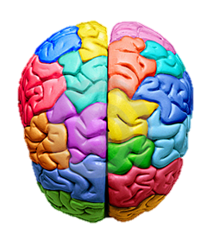
Introduction to
Psychology

Slide 2
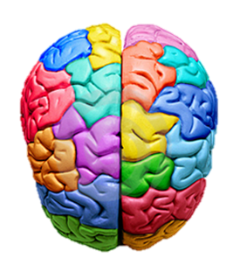
Introduction to Psychology
To Start: Fact or Fib..?
Decide whether each of the following statements are true or false.

Slide 3
Introduction to Psychology
Fact or Fib..?
Psychology is the same as Psychiatry?

Slide 4
Introduction to Psychology
Fact or Fib..?
FIB
Psychology is the same as Psychiatry?
Psychiatry is the study and treatment of mental illness. While psychology does look at mental disorders, it is the study of the mind and behaviour.

Slide 5
Introduction to Psychology
Fact or Fib..?
Psychology
is a
science?

Slide 6
Introduction to Psychology
Fact or Fib..?
FACT
Psychology
is a
science?
it is the scientific study of the human mind and behaviour!

Slide 7
Introduction to Psychology
Fact or Fib..?
Psychology
links well to
Sociology?

Slide 8
Introduction to Psychology
Fact or Fib..?
Psychology links well to Sociology?
FACT
Sociology is the study of humans in society. It requires similar skills in critical thinking and writing.

Slide 9
Introduction to Psychology
Fact or Fib..?
Psychologists can tell what you’re thinking?

Slide 10
Introduction to Psychology
Fact or Fib..?
Psychologists can tell what you’re thinking?
FIB
Psychologists can only study observable behaviours. They are not psychic!

Slide 11
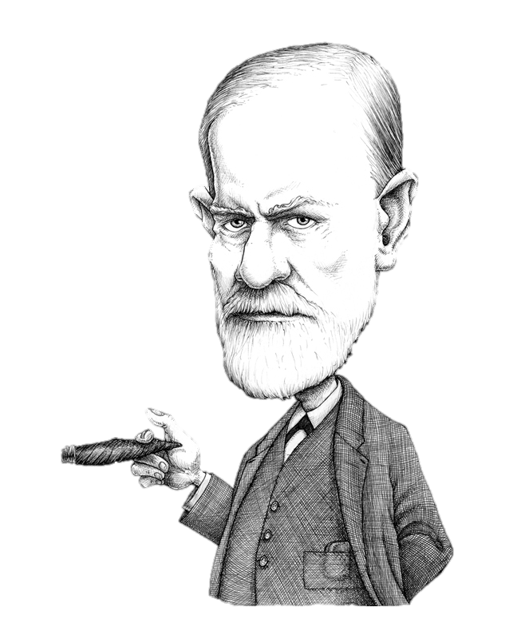
Introduction to Psychology
Fact or Fib..?
Sigmund Freud is a famous Psychologist?

Slide 12
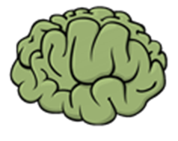
Introduction to Psychology
Fact or Fib..?
Sigmund Freud is a famous Psychologist?
We’ll study Freud’s theories in more detail later in the course!

Slide 13
Introduction to Psychology
Fact or Fib..?
A Psychologist might be interested in how we can improve our memory?

Slide 14
Introduction to Psychology
Fact or Fib..?
A Psychologist might be interested in how we can improve our memory?

Slide 15
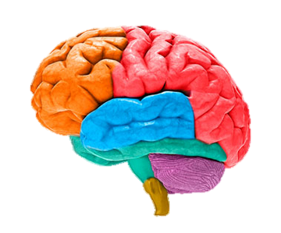
So, Psychology can be described as…
The study of the human mind, it’s functions and how it affects behaviour.

Slide 16
Today we will…
Introduce some of the approaches in Psychology
Explore how these can be applied to real life situations.

Slide 17
Task: Count how many times the players in white pass the ball…
http://www.youtube.com/watch?v=vJG698U2Mvo

Slide 18
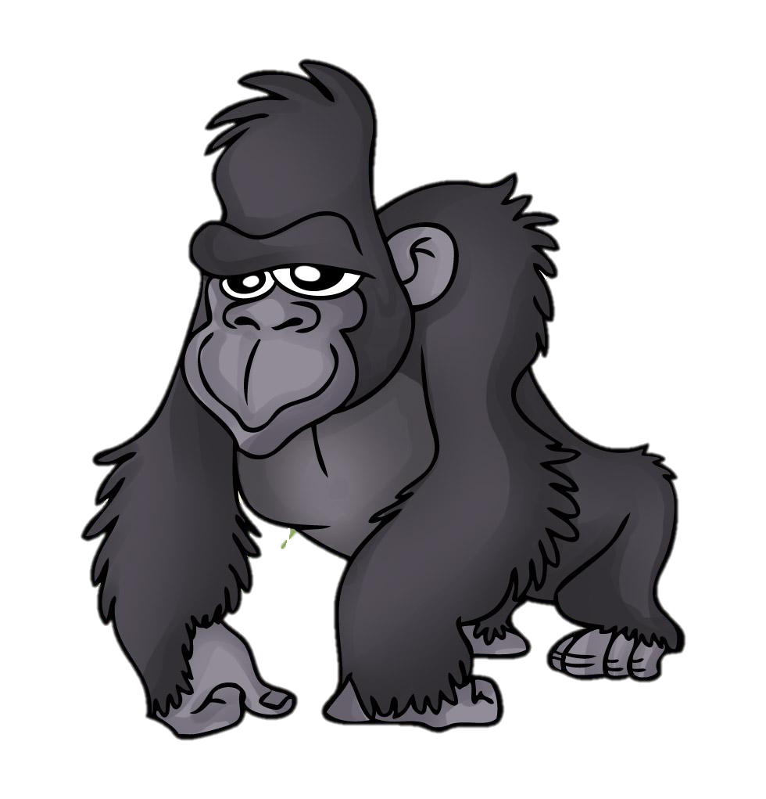
Task: What Gorilla?
3 Minutes
With the person next to you, discuss and note down ideas on:
Why is it possible to miss the Gorilla?
What could this suggest about our brains?

Slide 19
Approach 1: Cognitive Psychology
Our brains can’t pay attention to more than one thing at a time. This is called selective attention.
Our brain can also be fooled by optical illusions. This is called perception.
These processes fall into Cognitive Psychology which looks at mental processes and how we think.
As part of the GCSE Psychology course, we study memory one part of cognitive psychology.

Slide 20
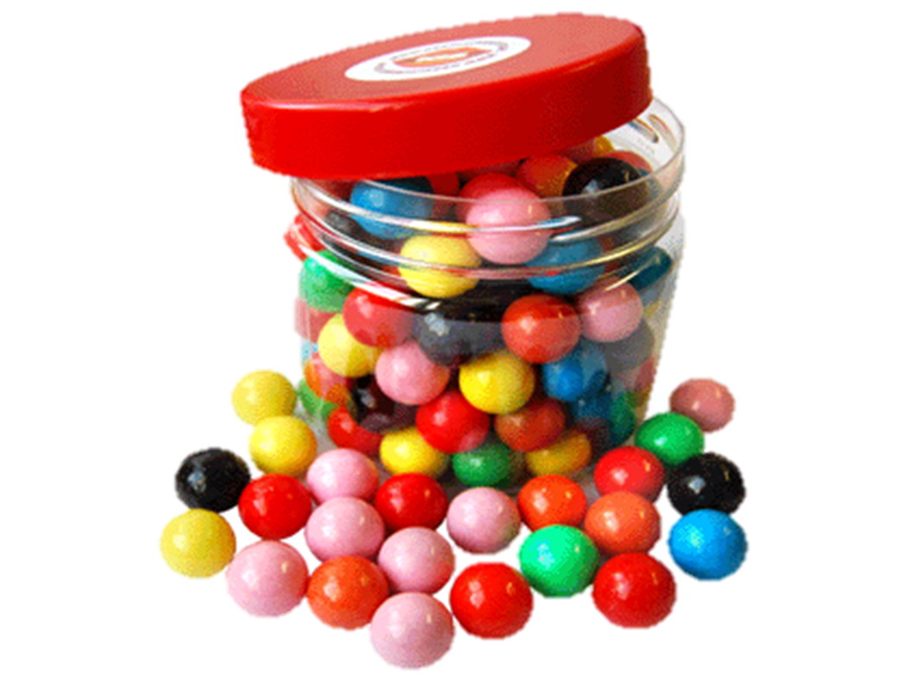
Task: How many sweets are there?
Pass the jar of sweets around the classroom.
Write down the answer on your individual white board.
Do this on your own! Keep it secret!
Hide your answer until everyone has finished.

Slide 21
Task: What did we find?
1 minute
You have one minute to:
If you changed your answer, think about and write down why you changed it? What did you base your second answer on?
If you didn’t change your answer, think about and write down reasons why other people did change their answers?

Slide 22
Approach 2: Social Psychology
Changing your behaviour in line with other people or external factors is called Social Influence.
This is part of Social Psychology, which looks at how people’s behaviour, thoughts and feelings are influenced by the actual or imagined presence of other people.

Slide 23
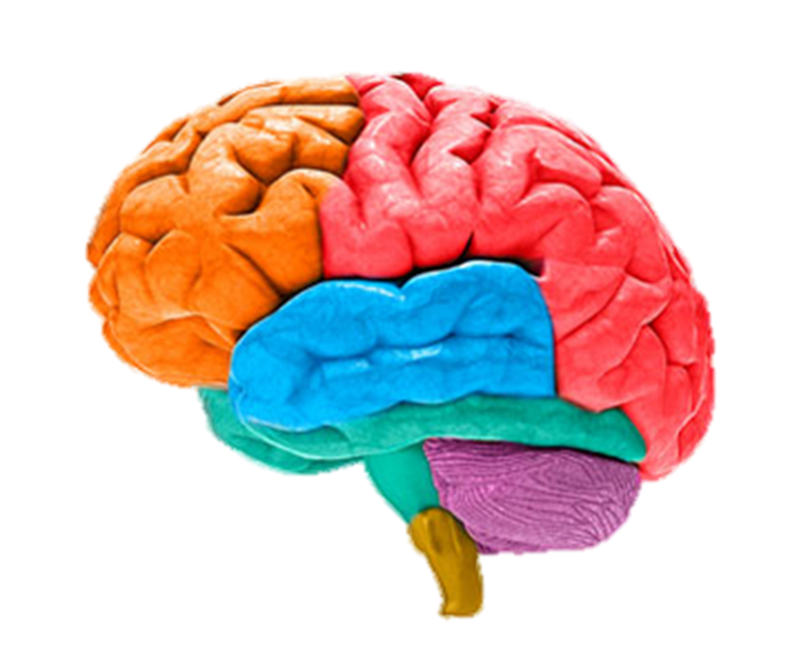
Task: Nature Versus Nurture
2 minutes
What do we mean by ‘nature versus nurture’?
How can this be applied to Psychology?

Slide 24
Approach 3: Biological Approach
Nature often refers to our biology. Factors we were born with such as genes, hormones and the structure of our brains.
Nurture refers to factors in our environment, how we learn.
In psychology this debate can be applied to certain behaviours to try and explain why these behaviours occur.

Slide 25
In GCSE Psychology…
We apply all of these approaches to different topics. These include:
Personality
Stereotyping & Prejudice
Sex & Gender
Learning
Aggression
Memory
Non Verbal Communication
We also have to consider how psychologists conduct and analyse their research. This is known as Research Methods.

Slide 26
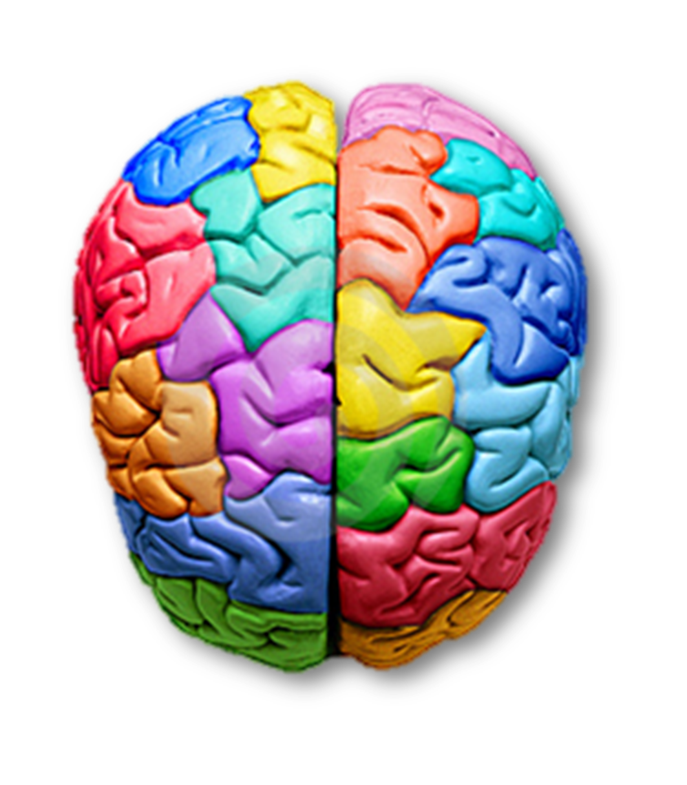
Task: Psychology Post It’s
2 minutes
A definition of Psychology
One thing you have learned about Psychology today.
Come and stick it on the brain board!

Slide 27
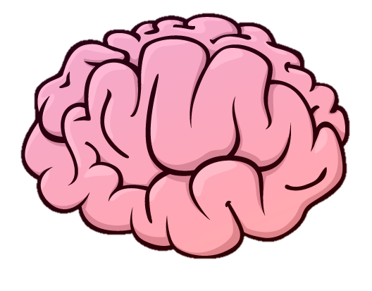
The Brain Board

